Slide 1
A New generation of science educators and communicators
Unexpected Career Aspirations in Museum Program Participants
Kathryn Rende
Dr. M. Gail Jones
Emma Refvem
Megan Ennes
Pam Huff

Slide 2
A Need for Professionals
Scientists, Educators, Communicators
Careers in science and engineering are growing rapidly with more than 9 million STEM jobs expected to be added to the U.S. workforce between 2012 and 2022¹. Accompanying the need for scientists, there is a growing need for science educators and communicators who can support public understanding of complex science issues.

Slide 3
Benefits of Out-of-School STEM
Informal Education and Career Pathways
While the literature indicates that after-school and informal science education programs have the capacity to generate interest in science and expose youth to a variety of STEM career pathways, little research exists on the role of these programs in encouraging complementary career paths in science education or communication.

Slide 4
Theoretical Framework
Social Cognitive Career Theory²
How academic and career interests develop.
How school and career choices are made.
How academic and career success is obtained.
Measures of interests, abilities, values.

Slide 5
Research Questions
Investigating science museum programs:
After participating in a science museum volunteer program, do youth select college majors in STEM fields, science communication or science education?

Slide 6
Methodology & Participants
Case Study Design
Twenty-one participants were interviewed about their experiences volunteering in a science museum during high school. Data were coded for factors related to social cognitive career theory.

Slide 7
Analyses
Qualitative Coding
Transcripts were open coded for themes related to social cognitive career theory and included: teaching, communication, competence, performance, recognition, science self-concept, science interest, career interest, and college interest.
A code book for subsequent coding was developed.
Interrater reliability of 0.83 (Krippendorf’s Cu-Alpha coefficient
Thematic analysis

Slide 8
Initial Findings
A New Generation of Educators and Communicators
Of the program participants who went on to college, 52.4% stated they are currently working in or are pursuing a career directly related to science education and teaching (outreach, informal, high school science, professorship), with 60% of remaining half still desiring a job where teaching science or communicating science to the public was part of their job requirements.

Slide 9
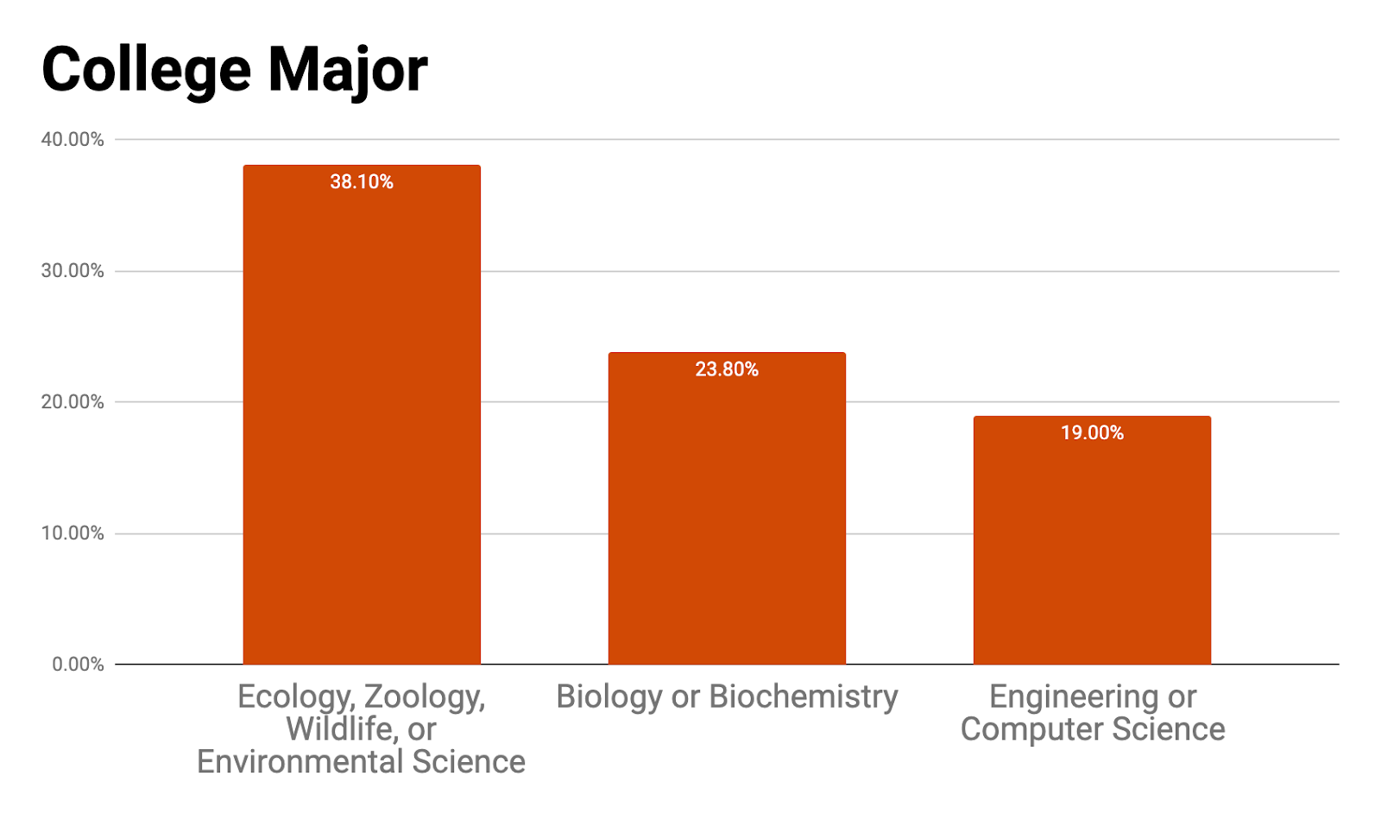
Results
Volunteer College Major Choice

Slide 10
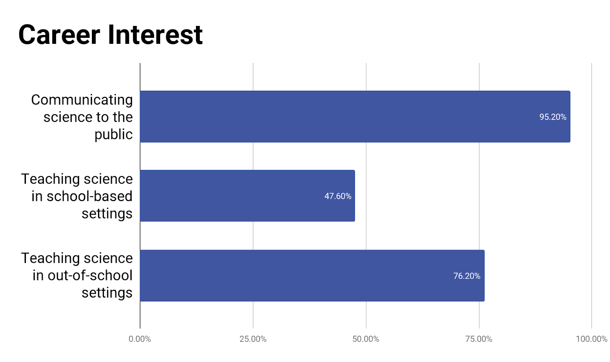
Results
Volunteer College Major Choice

Slide 11
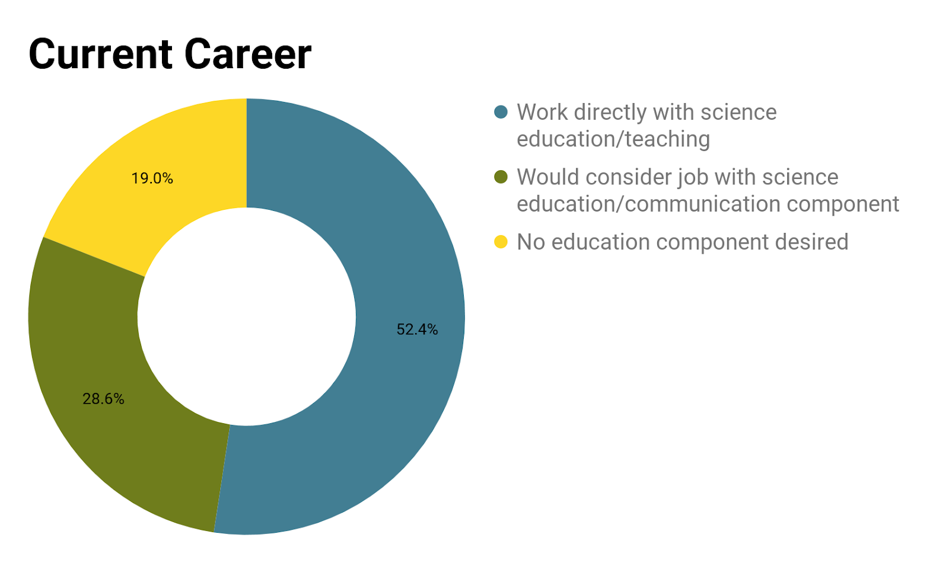
Results
Volunteer College Major Choice

Slide 12
Conclusions
Implications
These results suggest that museum volunteer programs may be places to foster and recruit the next generation of science teachers and science communicators. They provide important insight into how to develop teaching career motivations and interest

Slide 13
References
Selected References
(U.S. Bureau of Labor Statistics, (2014). Retrieved from https://www.bls.gov/bls/newsrels.html
Lent, R. W., Brown, S. D. and Hackett, G. 1994. “Toward a Unifying Social Cognitive Theory of Career and Academic Interest, Choice, and Performance” [Monograph]. Journal of Vocational Behavior 45:79-122.

Slide 14
Contact
PI: Dr. M. Gail Jones, NC State, mgjones3@ncsu.edu
Kathryn Rende, NC State, knrende@ncsu.edu
Emma Refvem, NC State, ejrefvem@ncsu.edu
Dr. Megan Ennes, University of Florida, mennes@floridamuseum.ufl.edu
Pam Huff, NC State, pmhuff@ncsu.edu

