Slide 1

Current NSF Funding Opportunities Related to Informal STEM Learning
February 29, 2016

Slide 2
Highlights of GPG 16-1 Changes
Submission deadline enforced (Ch I.F.)
Authorized Organizational Representative (AOR) signature (Ch I.G.2)
New single-copy document: Collaborators & Other Affiliations Information (Ch II.C.1.e)
Biographical sketches (Ch II.C.2.f)
Current & pending support (Ch II.C.2.h)
Project description [Ch II.C.2.d(iii)]
Notes:
Submission deadline enforced – 5pm local
FL will cut off automatically
G
AOR signature
must provide the proposal certifications concurrently with submission of the proposal
rants.gov may let you upload/transmit after 5pm, but NSF will RWR late proposals (g.gov has 24-48 hr turn around
Single copy docs
DO NOT put these items in Biographical sketches any more
Required for each senior project personnel
Bio sketches
For each senior personnel: Must upload separately, not as single PDF
For other personnel: should be combined into single PDF
Curr/Pend
all current project support should be listed in this section of the proposal (including internal funds allocated toward specific projects.)
must now be uploaded as a single PDF file for all senior personnel; no combo pdf allowed anymore
ProjDescrp
No ULRs allowed

Slide 3
Highlights of AAG 16-1 Changes
Grantee Notifications to NSF and Requests for NSF Approval (Ch II.A.2)
Technical Reporting Requirements (Ch II.D.)
Public Access to Copyrighted Material (Ch VI.D.2.c)
Notes:
AAG – Award and Administration Guide
Grantee Notifications to NSF and Requests for NSF Approval
All must be electronically signed and submitted by the AOR via use of NSF’s electronic systems
Technical Reporting Requirements
Annual: no later than 90 days prior to end of budget period (used to say “within”)
Final: no later than 120 days following expiration of the grant (used to be 90 days)
Public Access to Copyrighted Material
New section! (Ch VI.D.2.c)

Slide 4
Reviewer reflections on recent submission cycle
Thoughts about the solicitation
Proposal category challenges
Proposal time scales and budgets
Research and Evaluation
Solicitation-specific criteria
Submitter support
Notes:
Thoughts about current solicitation
provided more clarity about NSF/DRL and AISL goals and directions
AISL 4 priority areas: reviewers found them useful lenses for IM and BI, BUT not all proposals attended to these
Proposal category challenges
CP (most proposals did not hit the mark);
EP (so many are not paying attention to the purpose – trying to do mini projects instead of PoC);
RSP vs ECR (applied with explicit connection to practice outcomes vs foundational research with outcomes that may build to future research)
Proposal timescales and budgets
Longer is not always better – justifications for 4+ yrs proposals is weak; proposals tend to ask for more in outyears than can be known at the beginning; think more concisely
Just because $3M is available, doesn’t mean to default to that ask; Budgets need to map better to the project narratives
R&E
Good to see proposers thinking about how the work is generating knowledge for the field
The two activities are still conflated in many proposals (not limited to AISL)
Solicitation-specific criteria
Important for thinking about the extent to which proposers truly understand their audience(s)
Reviewers would like to see this called out better in proposals;
Applicant support
To what extent is current webinar 101 helpful?
Other suggestions we might explore?

Slide 5
EAGERs, RAPIDs, Supplements
Does AISL fund these?
Definitions
How?
Notes:
Does AISL fund them?
Yes
EAGERs/RAPIDs:
through open requests
Through DCLs (e.g., Ebola DCL, Maker,
SUPPS:
Consultation w/ your PO
Definitions
See GPG
EAGERs – the onus is on the submitter to justify why the proposal could not be submitted to the regular program call
RAPIDS – the litmus test (educational equivalent of the erupting volcano where there is time-limited window of opportunity)
Supps – Not meant to recoup a budget reduction that occurred at the time of funding; criteria is explicit in the GPG
How?
First step - Talk to a PO

Slide 6
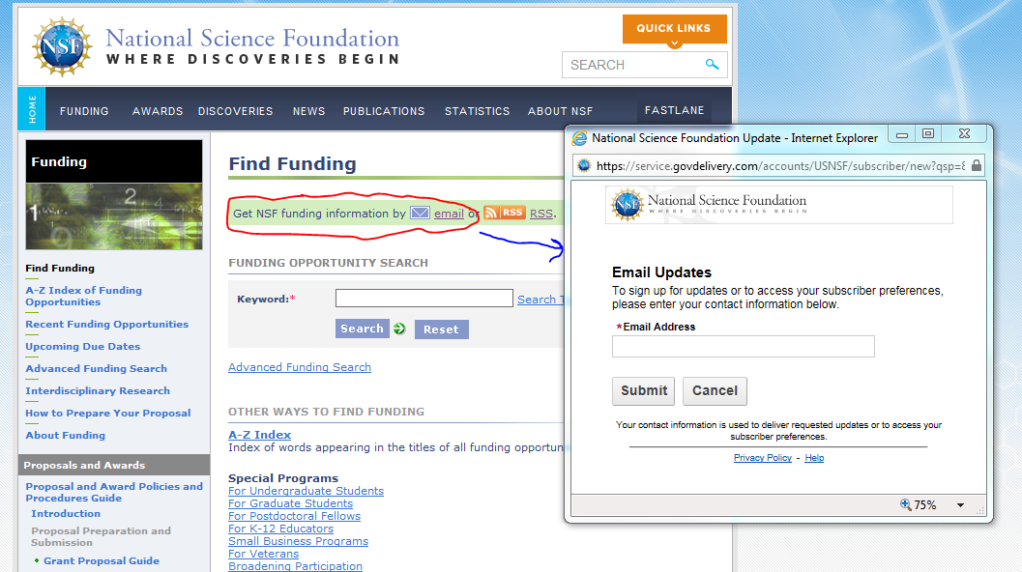
Keeping track of opportunities

Slide 7
Questions?
Notes:
PI Webinars – How useful?

Slide 8
Funding Opportunities for ISE in EHR

Slide 9

Discovery Research PreK-12 (DRK-12)
https://www.nsf.gov/funding/pgm_summ.jsp?pims_id=500047

Slide 10

Innovative Technology Experiences for Students and Teachers (ITEST)
https://www.nsf.gov/funding/pgm_summ.jsp?pims_id=5467

Slide 11

Promoting Research and Innovation in Methodologies for Evaluation (PRIME)
http://www.nsf.gov/funding/pgm_summ.jsp?pims_id=504995

Slide 12

EHR Core Research (ECR)
http://www.nsf.gov/funding/pgm_summ.jsp?pims_id=504924

Slide 13

Science Learning+
https://www.nsf.gov/funding/pgm_summ.jsp?pims_id=504793

Slide 14

STEM+Computing Partnerships (STEM+C)
https://www.nsf.gov/funding/pgm_summ.jsp?pims_id=505006

Slide 15

Faculty Early Career Development Program (CAREER)
https://www.nsf.gov/funding/pgm_summ.jsp?pims_id=503214

Slide 16
Questions?
Notes:
Q/A on programs

Slide 17
Funding Opportunities for ISE across NSF

Slide 18

Cyberlearning and Future Learning Technologies (Cyberlearning)
https://www.nsf.gov/funding/pgm_summ.jsp?pims_id=504984

Slide 19

DCL: Integrated NSF Support Promoting Interdisciplinary Research and Education (INSPIRE)
http://www.nsf.gov/pubs/2016/nsf16023/nsf16023.jsp

Slide 20

DCL: Inclusion across the Nation of Communities of Learners of Underrepresented Discoverers in Engineering and Science (INCLUDES)
http://www.nsf.gov/pubs/2016/nsf16048/nsf16048.jsp

Slide 21
What are Dear Colleague Letters (DCLs)?
that’s a really good question….

Slide 22

DCL: Enabling the Future of Making to Catalyze New Approaches in STEM Learning and Innovation
http://www.nsf.gov/pubs/2015/nsf15086/nsf15086.jsp

Slide 23

DCL: Supporting Research Advances in Smart and Connected Communities
http://www.nsf.gov/pubs/2015/nsf15120/nsf15120.jsp

Slide 24
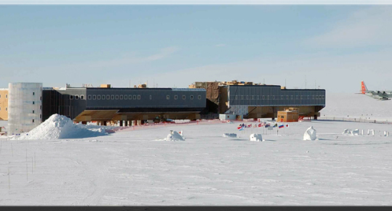
DCL: Support for Engaging Students and the Public in Polar Research
http://www.nsf.gov/pubs/2015/nsf15114/nsf15114.jsp

Slide 25

Computer Science for All
http://www.nsf.gov/news/news_summ.jsp?cntn_id=137529

Slide 26
Other DCLs
DCL: Stimulating Research Related to the Science of Broadening Participation
http://www.nsf.gov/pubs/2015/nsf15066/nsf15066.jsp
DCL: Stimulating Research on Effective Strategies in Undergraduate STEM Education at Two-Year Hispanic Serving Institutions
http://www.nsf.gov/pubs/2015/nsf15078/nsf15078.jsp

Slide 27
Innovations at the Nexus of Food, Energy, and Water Systems (INFEWS)
Energy
Food
Water
https://www.nsf.gov/funding/pgm_summ.jsp?pims_id=505241

Slide 28
Questions?
Notes:
Final Q/A

