Slide 1

Association of Science-Technology Centers
Annual Conference
October 18-October 21, 2014
High Expectations
High Support:
Effective Professional Development Strategies for Teens
Lucy Green, Museum of Science Boston
Don Wittrock, Center for Aquatic Sciences at Adventure Aquarium
Kathy Fuller, National Aquarium
Liz Whitlinger, New England Aquarium
Josh Kemper, Pacific Science Center
Joy Delyria, Pacific Science Center
Association of Science-Technology Centers(ASTC)
Annual Conference
October 18-21, 2014

Slide 2
16 Candles
Think about yourself at 16 years old – the setting, time, the feelings.
Take 5 minutes to answer these questions about yourself at age 16.
The Year is _____________________________________________
I live in __________________ (City/State) Population ___________
I go to _________________________________________________
I’m good at_____________________________________________
Signs of the times (social/political) include: ____________________
After school/work, I hang out at _____________________________
My friends and I eat __________________ and drink ____________
Today, I’m wearing _______________________________________
For fun, I _______________________________________________
The music I listen to is ___________ and it is telling me to ________
I’m worried about what will happen to me if _____________________
I’m getting lots of pressure to ________________________________
One thing I feel proud about is _______________________________

Slide 3
Expectations & Agreements
Silence or Turn Off Phones
Don’t Yuck My Yum
Step Up Step Back
Be Respectful
Be Flexible
Try On New Roles
Ask for Help When you Need It
Remember Youth Work starts with YOU Work
Notes:
Any Agreements we want to add?

Slide 4
Agenda
Introductions
Break out Rotations: 10 Minutes Each
  Employability & Job Readiness
  Presentation & Public Speaking
  Science Content & Presentation
  College & Career Preparedness
  Inquiry, Public Speaking, and Comfort talking to Visitors
Debrief

Slide 5
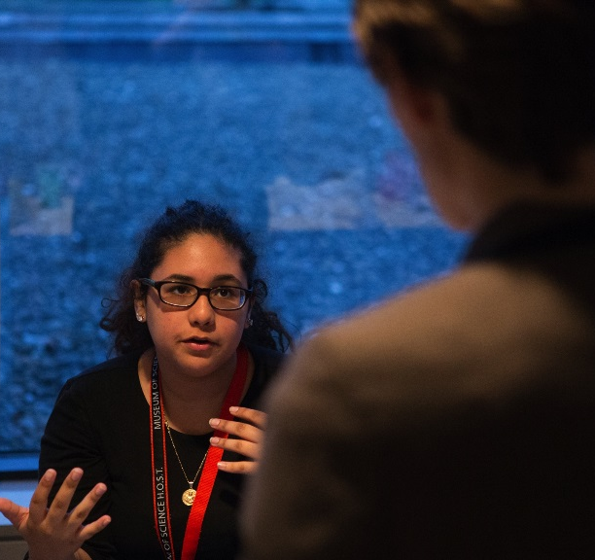
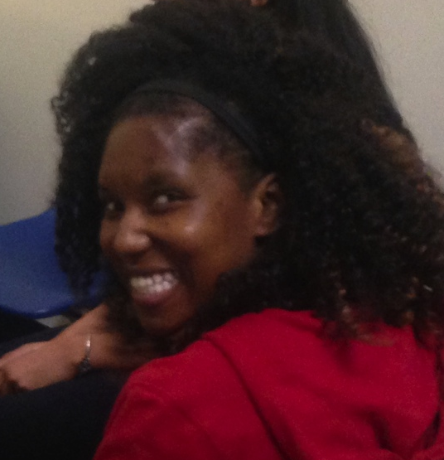
Museum of Science, Boston
Youth Programs
Kalya Matos
Maria Lewis

Slide 6
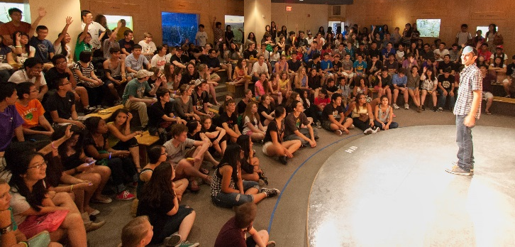

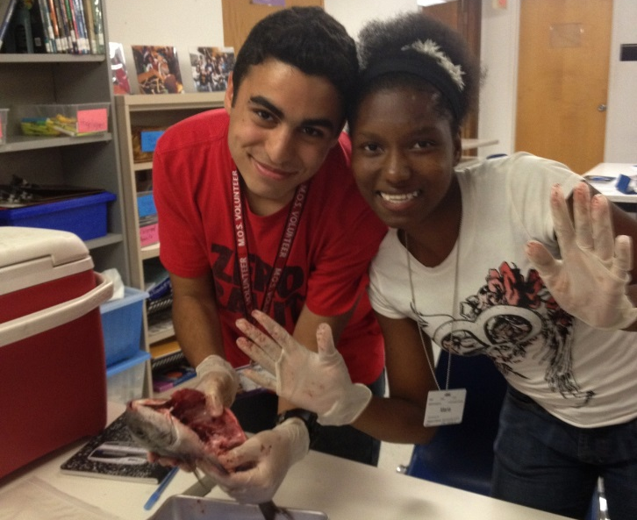
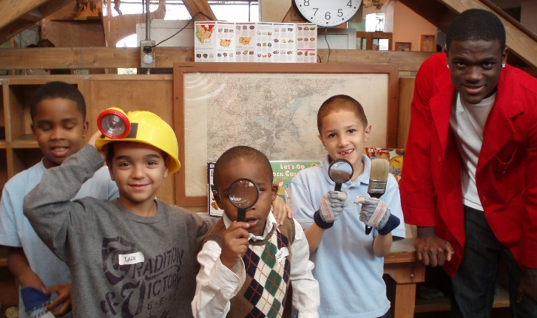
What Teens Do
Program Assistant - 14 Teens
Help Train Volunteers & Interns
Project Leaders for Intern Projects
Plan & Implement Teen Only Events
Paid Internship - 55 Teens
Museum Educator
Project Based
  Working in a group to help create activities
Role Model for Volunteers
Volunteer - 125 Teens
Museum Educator
Notes:
Before diving into training teens to do what they do, we want to start with what they actually do.
The Museum has a career ladder for teens that increases in responsibility as teens increase in knowledge, maturity, and ability. All positions start with orientations where expectations are set clearly and policies are gone over.
All teens start as volunteers where they work as Museum educators talking to the public about science. They receive a 30 minute training prior to every shift and work 1 on 1 with a Museum staff member to learn science content and facilitation skills.
Once teens have completed at least 50 hours of volunteer time they are eligible to apply for a paid internship. As a paid intern they help create activities to be done on the floor with visitors. They continue to receive the 30 minute training and work 1 on 1. With the added responsibility comes the added support of a weekly workshop focused on professional development.
Once teens have completed a successful internship they are eligible to apply to a Teen Staff Position called a program assistants. Program assistants have the most responsibilities in the Museum and often help train other teen volunteers and interns.
We (Maria & Kayla) are both program assistants and have been members of our Teen Science Leadership Council.

Slide 7
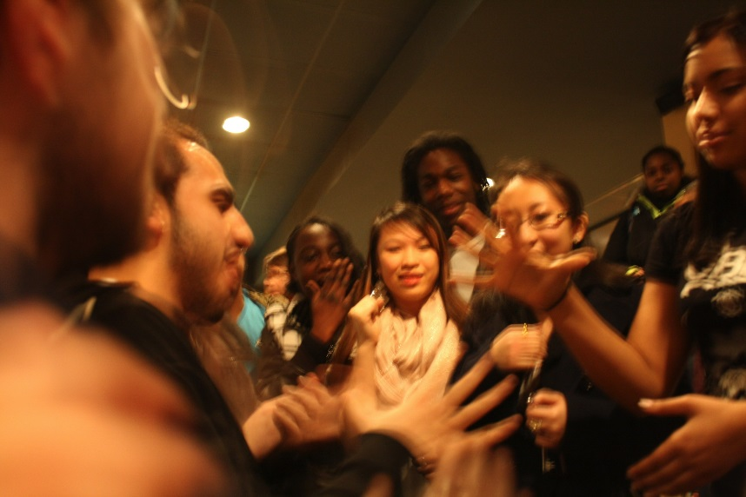
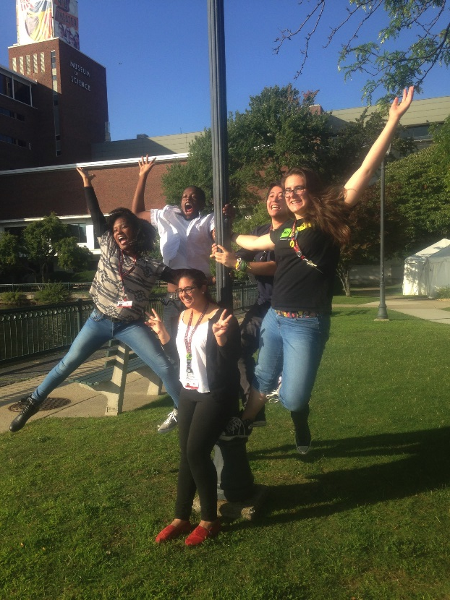
Employability & Job Readiness
Employability Skills:
Juggling Responsibilities
Communication Skills
Getting and keeping a job
  Introducing & Upholding Policies
Tips and Tricks:
Start with icebreakers that relate to the training
Use Real Life Scenarios
Make Things Interactive
Debrief Everything
Be Transparent
Notes:
In our break out rotations we will be focusing on Employability and Job Readiness.
For many of our teens, their work at the Museum is the first job they have ever had. We do a lot of work on training teens on employability skills. We’ll be going over how teens are trained to juggle all their responsibilities, communicate with peers and supervisors. We will also be focusing on how Museum policies are introduced and upheld.
Some of our tips and tricks when you are thinking about providing training that focuses on employability skills are to always start with an icebreaker. The best icebreakers relate to the training and get students to think creatively. Using real life scenarios that have actually happened in the Museum help teens gain an understanding of what will happen when they go out on the floor.
Try and make things as interactive as possible. Nobody likes to be lectured at. But make sure that you debrief everything and allow teens the opportunity to
Be transparent, talk about why a policy is in place.

Slide 8

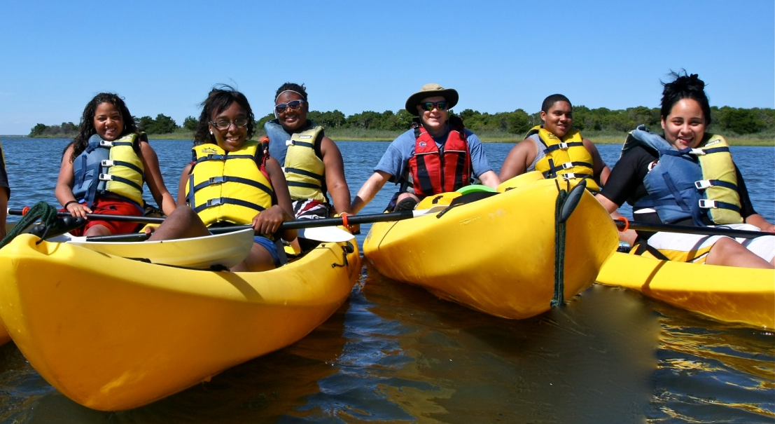
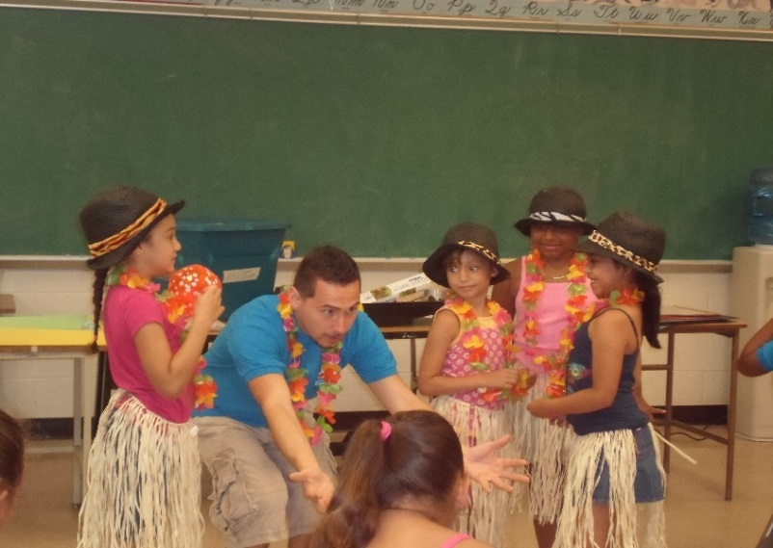
Community and Urban Science Enrichment Program
Comprehensive, Year-Round Youth Development Program for Youth Grades 8-12 and Beyond!
Engaging “At Potential”Youth for 21 years!

Slide 9
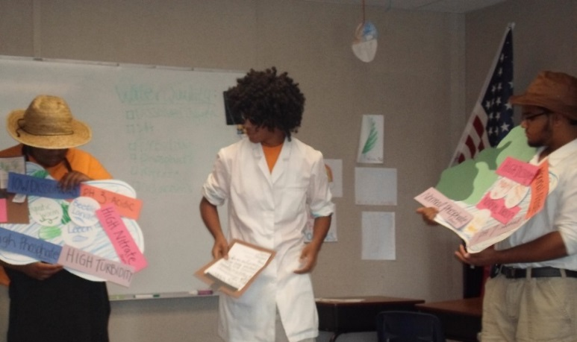
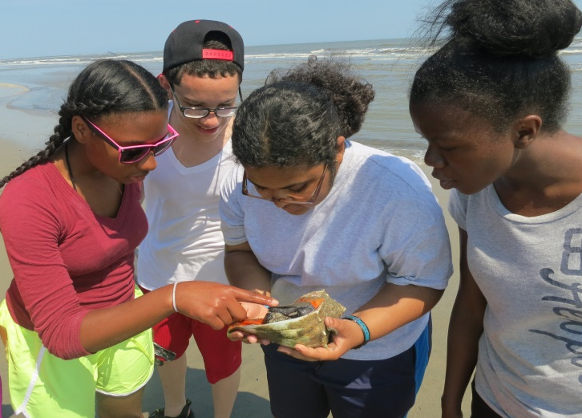
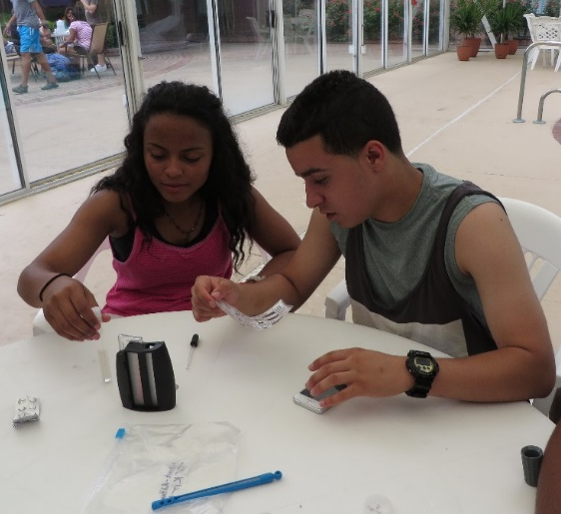
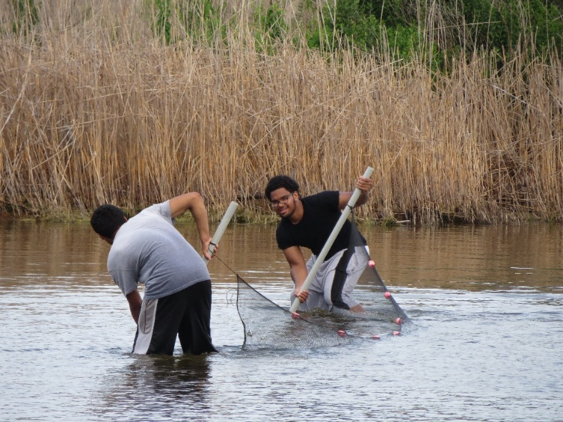
The CAUSE Program Combines
Science and Field
Work Experiences!
Students Teach Summer
Camp to Younger Children
Using Creative Theatrical
Skits!
Paid Work Experience
and Mentoring!
Science, Leadership, E-5 Model, and Theatrical Training up to 3 Days Per Week!

Slide 10
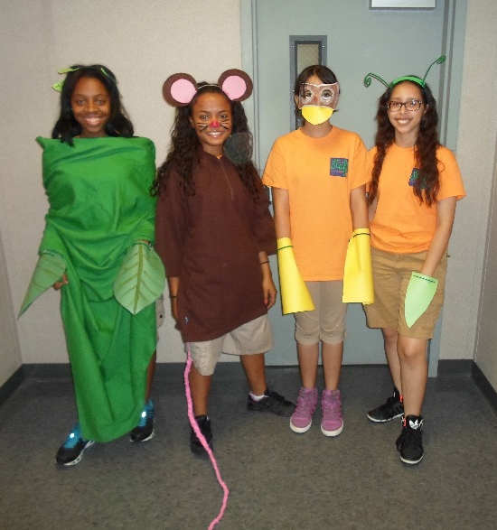
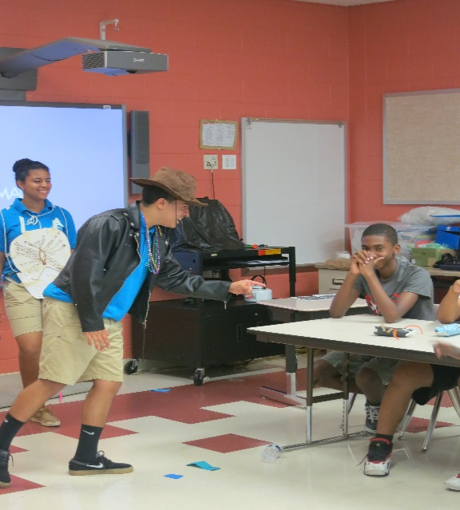
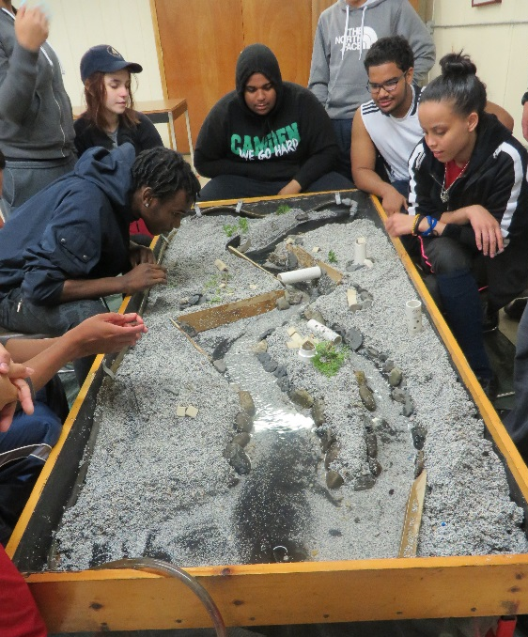
At Our Table You Will….
Develop Teamwork!
Spark Creativity!
Hone Presentation and Public Speaking Skills!
Reflect on Your Experience and Progress!

Slide 11

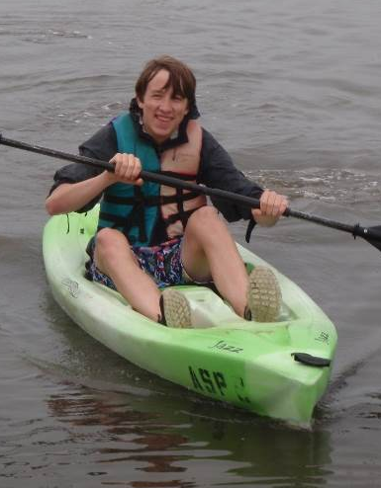
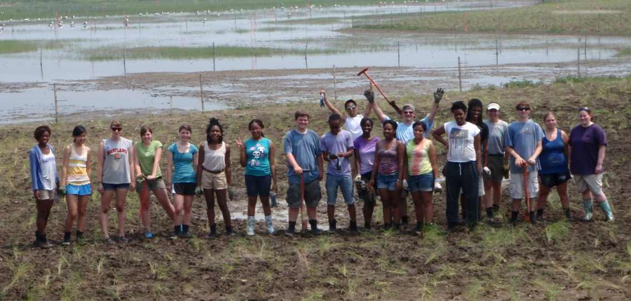
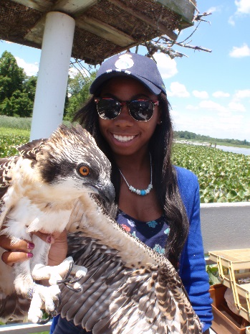
Aquarium on Wheels Program
Begun in 1996, Aquarium on Wheels is an award-winning afterschool and summer program for Baltimore area high school students. The program combines scientific research, conservation activities, job training, and the theater arts to promote environmental stewardship. Students increase their scientific knowledge; gain job skills; develop creativity and communication skills; and develop and achieve meaningful life goals as confident, responsible members of the community.

Slide 12
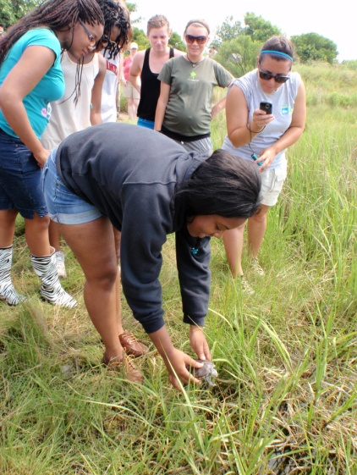
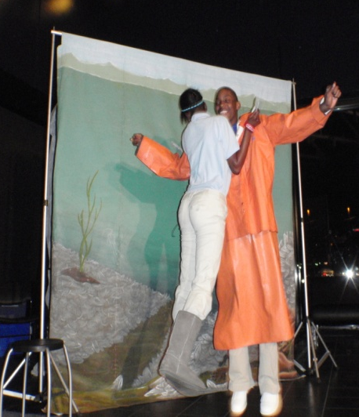
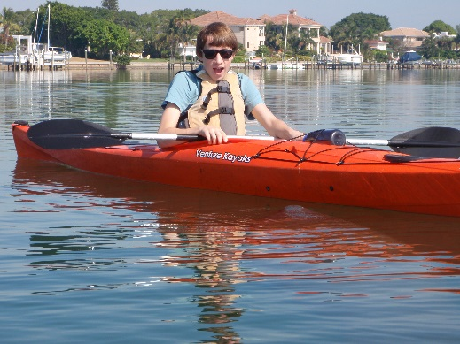

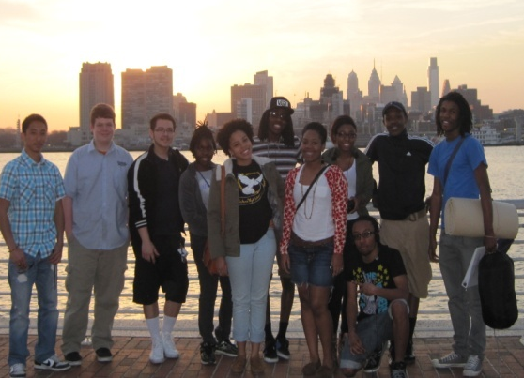
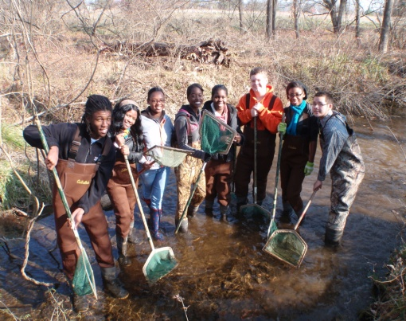
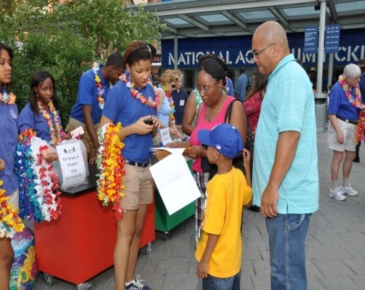
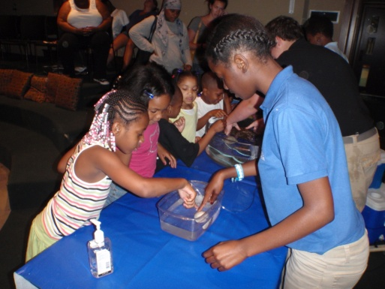

What Aquarium on Wheels Means to Us
Hands on work
Growing as a family
Exploring new things
Giving back to the community

Slide 13
Career and College Exploration
Liz Whitlinger
Teen Programs Supervisor
New England Aquarium
lwhitlinger@neaq.org

Slide 14
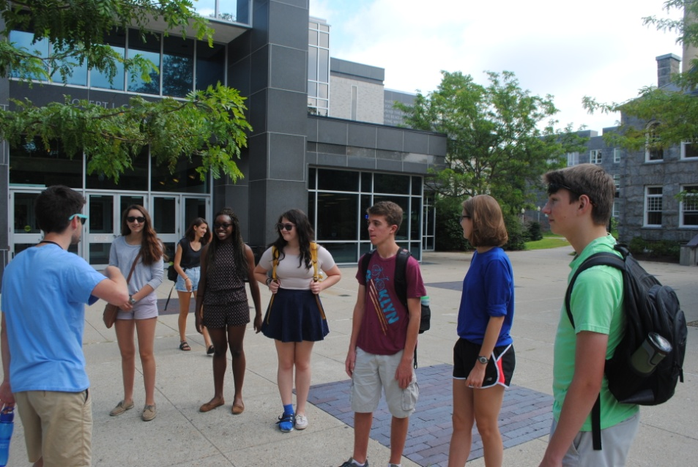
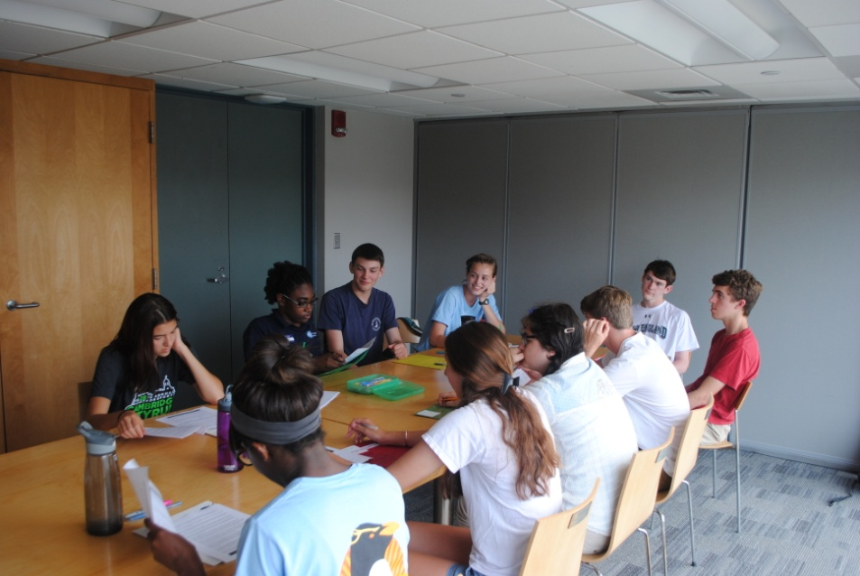
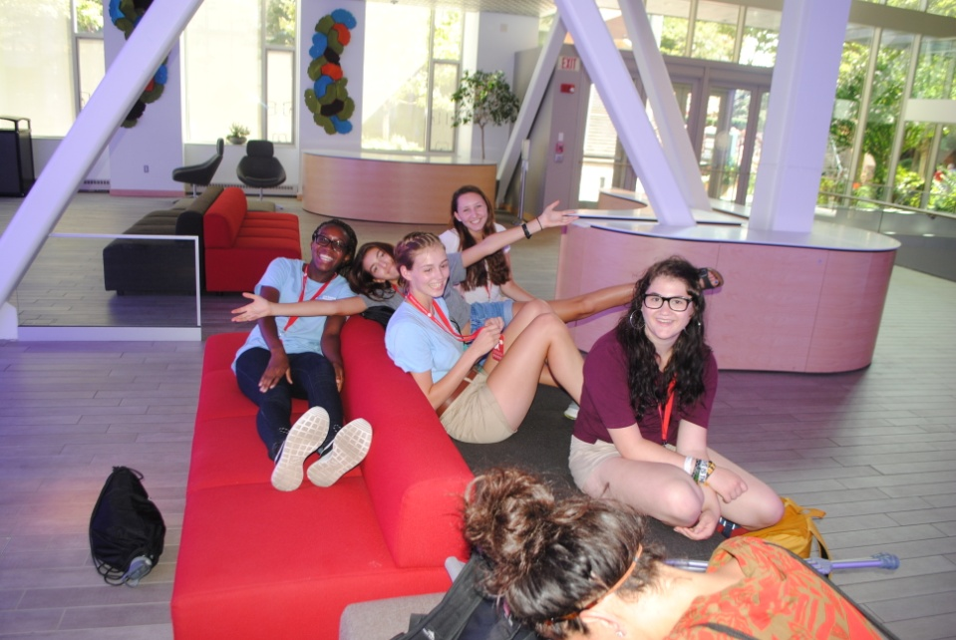
College Workshop
About College
Application Process
Essays and Interviews
Financial Aid
College Visits

Slide 15
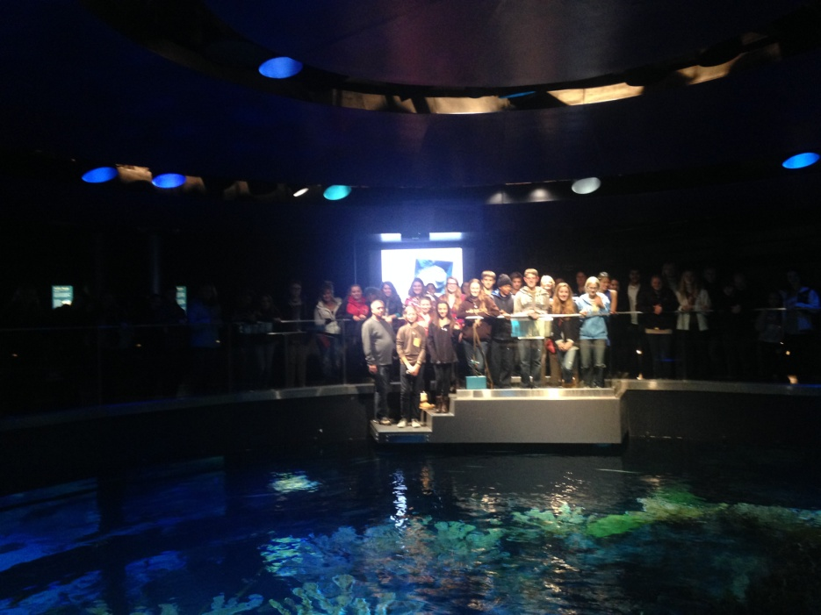
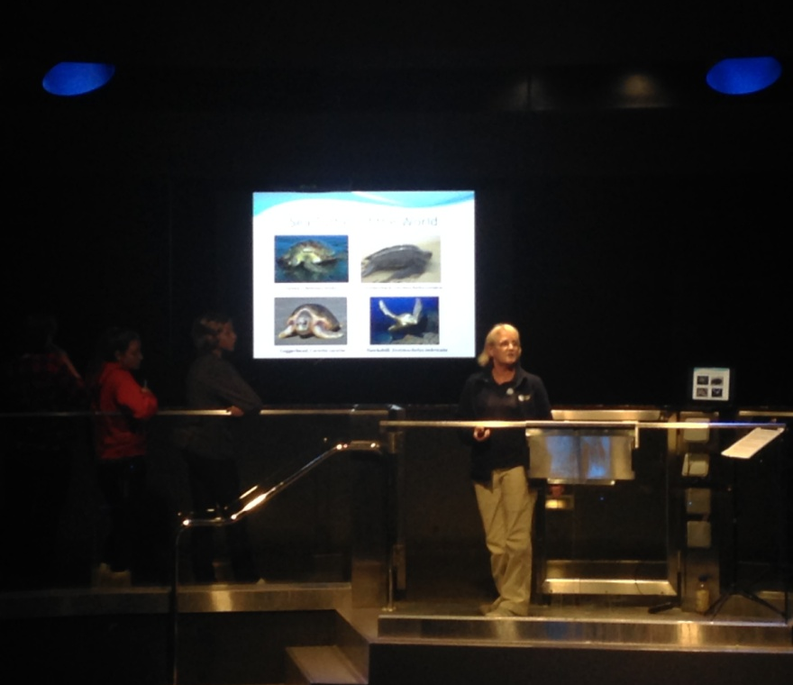
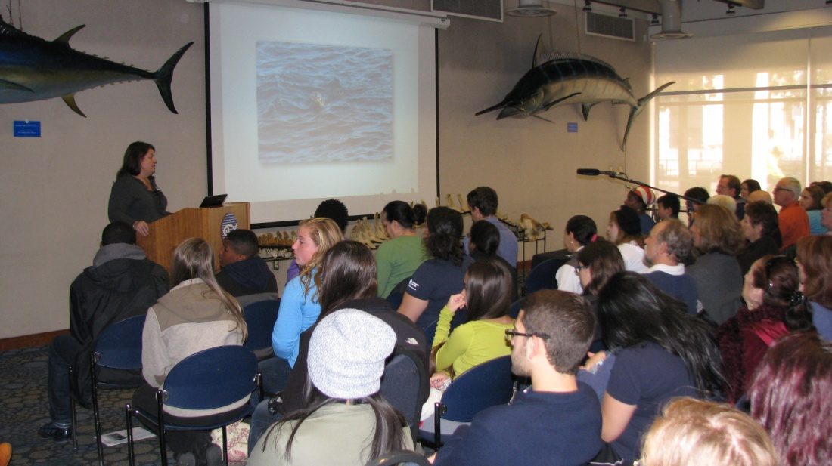
Career Pathways
Monthly Program
Evening or weekend
2 hours
Presentation from expert

Slide 16
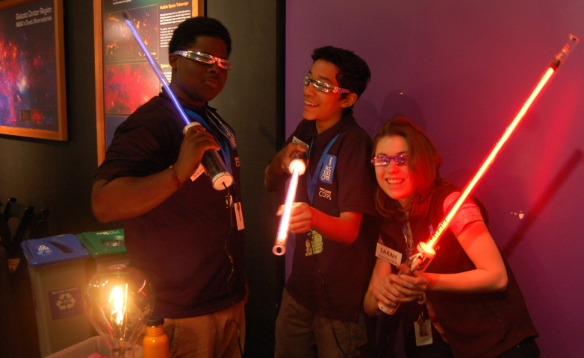
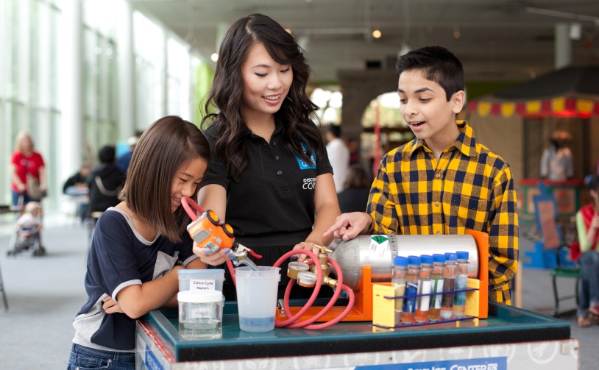
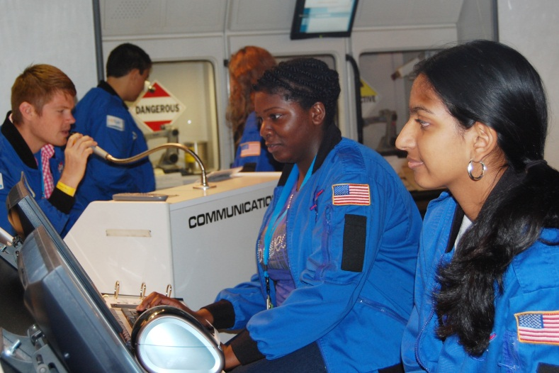
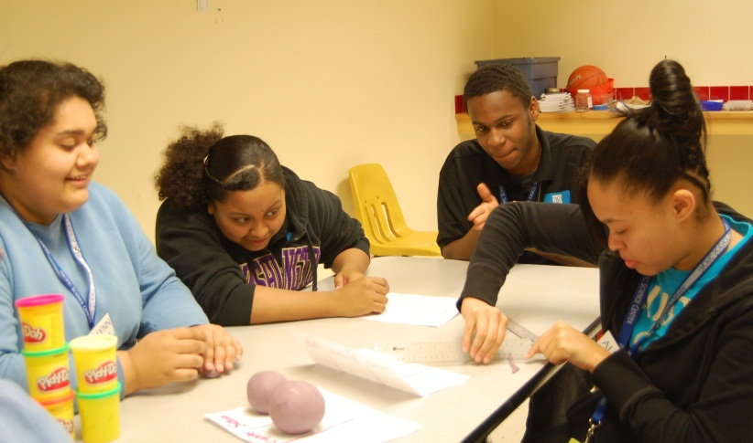
Pacific Science Center, Seattle, WA
Josh Kemper, Discovery Corps Supervisor
Joy DeLyria, Interpretive Programs Supervisor

Slide 17
What Does A Discovery Corps Member Do?
Staff positions and interact with visitors at Pacific Science Center
Multiple opportunities at internships available through the program
Many STEM career related field trips and college visits focusing on local organizations

Slide 18
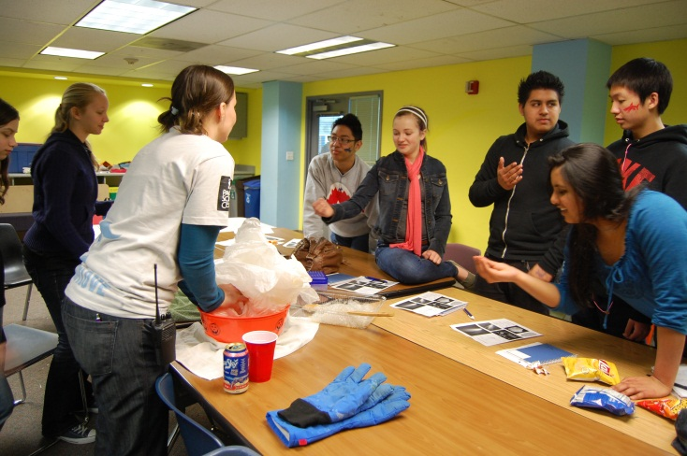
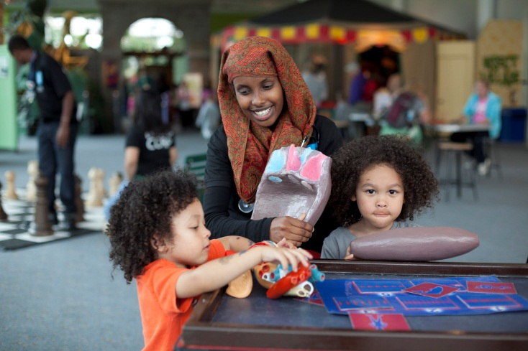
How Does A Discovery Corps Member Learn?
Series of positions scaled from least difficult to most difficult in terms of science content and presentation skill
Workshops and trainings at each level of the career ladder
Shadowing, mentoring, and check-ins with adult staff who do similar jobs
Verbal check-outs for science content and formal observations for presentation skill
Written tests to measure and quantify science learning

Slide 19
Expectations & Agreements
Silence or Turn Off Phones
Don’t Yuck My Yum
Step Up Step Back
Be Respectful
Be Flexible
Try On New Roles
Ask for Help When you Need It
Remember Youth Work starts with YOU Work
Notes:
Any Agreements we want to add?

Slide 20
Lucy Green:
lgreen@mos.org
617-589-0344

