Slide 1
Association of Science-Technology Centers Annual Conference October 18-October 21, 2014
Engaging Underrepresented Populations in your STEM Programming: A place-based approach
Envision your ideal activity or exhibit. What groups are excitedly participating in your STEM programming?
Tweet your vision to @c_keefe, #ASTC2014; we’ll be using your responses to guide the workshop.
Association of Science-Technology Centers(ASTC)
Annual Conference
October 18-21, 2014

Slide 2
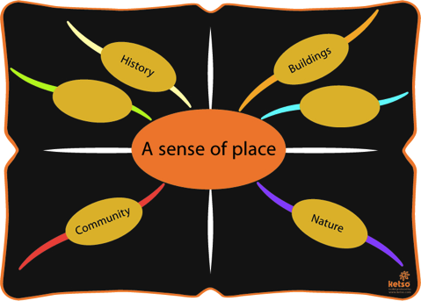
Introduction
Why use neighborhood-based activities?
Construction and Use
Social and Natural History
Association of Science-Technology Centers(ASTC)
Annual Conference
October 18-21, 2014

Slide 3
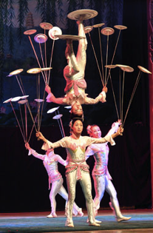
Introduction
How to use this toolkit
Association of Science-Technology Centers(ASTC)
Annual Conference
October 18-21, 2014

Slide 4
Introduction
Best practices for innovation
Constantly keep your end goals in mind
Realistically assess your strengths and limitations
Involve your target audience as much as possible
Don’t reinvent the wheel
Association of Science-Technology Centers(ASTC)
Annual Conference
October 18-21, 2014

Slide 5
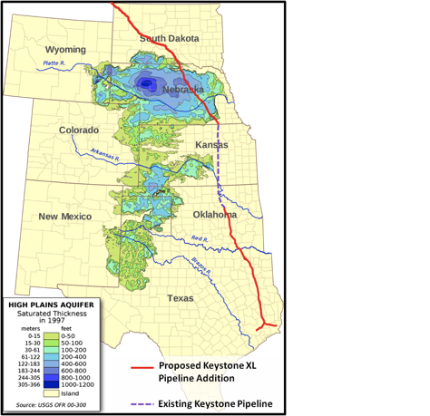
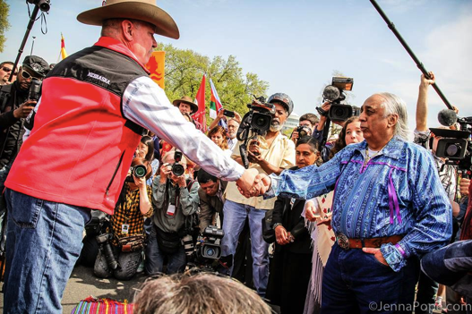
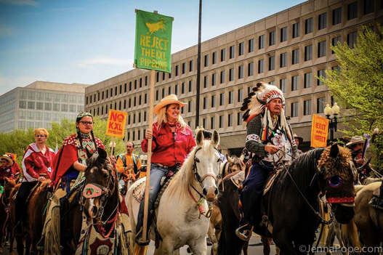
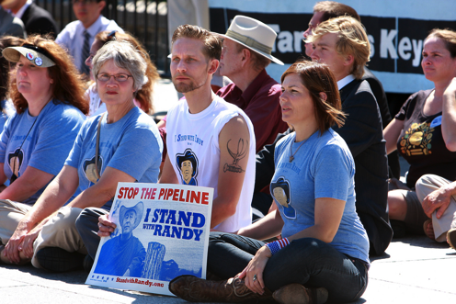
Introduction
Case studies
Association of Science-Technology Centers(ASTC)
Annual Conference
October 18-21, 2014

Slide 6
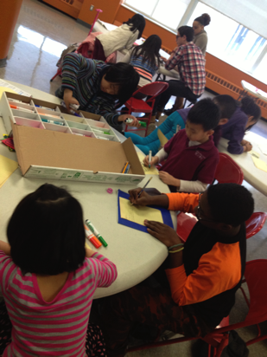
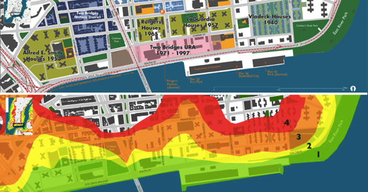
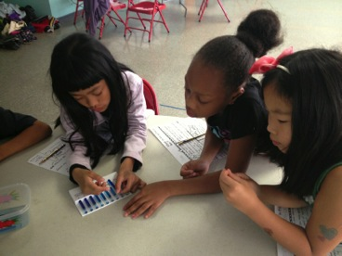
Introduction
Case studies
Association of Science-Technology Centers(ASTC)
Annual Conference
October 18-21, 2014

Slide 7
Before you begin: Research
Determine who your target audience is
What demographics do you want to reach?
What demographics do you need to reach?
What groups will benefit most from your outreach?
Association of Science-Technology Centers(ASTC)
Annual Conference
October 18-21, 2014

Slide 8
Before you begin: Research
Know your audience’s strengths & needs
Attend town hall & community board meetings
Read local blogs and newspapers
Visit community based organizations
Contact local PTA reps, principals, etc.
Association of Science-Technology Centers(ASTC)
Annual Conference
October 18-21, 2014

Slide 9
Before you begin: Research
Get to know local geological, ecological, cultural and political history
Government websites: EPA, DEP, DEC
Amateur & Enthusiast groups
Local Historical Society
Local Library
Association of Science-Technology Centers(ASTC)
Annual Conference
October 18-21, 2014

Slide 10
Before you begin: Research
Involve your target audience in planning
Recruit community members for focus groups/planning committees
Accommodate for your audience (timing, location, childcare, refreshments, etc.)
Association of Science-Technology Centers(ASTC)
Annual Conference
October 18-21, 2014

Slide 11
Association of Science-Technology Centers Annual Conference October 18-October 21, 2014
Let’s give it a try….
Association of Science-Technology Centers(ASTC)
Annual Conference
October 18-21, 2014

Slide 12
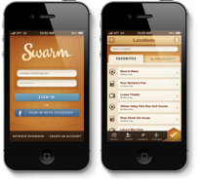
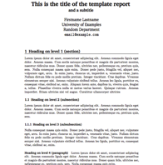
Designing Engaging Programming
Choose your medium
Association of Science-Technology Centers(ASTC)
Annual Conference
October 18-21, 2014

Slide 13
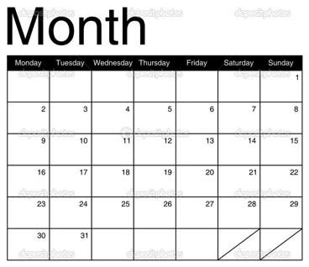
Designing Engaging Programming
Choose your frequency of engagement
Association of Science-Technology Centers(ASTC)
Annual Conference
October 18-21, 2014

Slide 14
Designing Engaging Programming
Decide on a method for evaluating your program
Quantitative? Qualitative?
Internal or external review?
Association of Science-Technology Centers(ASTC)
Annual Conference
October 18-21, 2014

Slide 15
Designing Engaging Programming
Begin collecting data
How are you going to maintain your data?
Do you have all permissions needed?
Do you have privacy requirements?
Association of Science-Technology Centers(ASTC)
Annual Conference
October 18-21, 2014

Slide 16
Designing Engaging Programming
Have focus group review before you launch
Association of Science-Technology Centers(ASTC)
Annual Conference
October 18-21, 2014

Slide 17
Association of Science-Technology Centers Annual Conference October 18-October 21, 2014
Try it!
Association of Science-Technology Centers(ASTC)
Annual Conference
October 18-21, 2014

Slide 18
Building Momentum
Model how STEM professionals share results
Meta-teach the scientific/design process
Association of Science-Technology Centers(ASTC)
Annual Conference
October 18-21, 2014

Slide 19
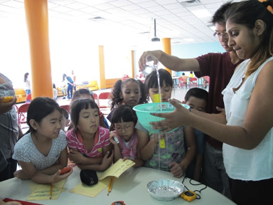
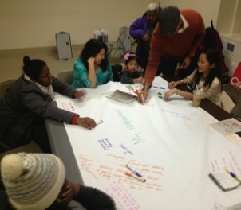
Building Momentum
Engage your target audience in the sharing/presentation process
Association of Science-Technology Centers(ASTC)
Annual Conference
October 18-21, 2014

Slide 20
Building Momentum
Always have a next step ready so you can invite your audience to future events while you have their attention
Association of Science-Technology Centers(ASTC)
Annual Conference
October 18-21, 2014

Slide 21
Association of Science-Technology Centers Annual Conference October 18-October 21, 2014
Questions?
Twitter: @c_keefe
Email: christine@wegrokit.org
Phone: (347) 566-GROK
Association of Science-Technology Centers(ASTC)
Annual Conference
October 18-21, 2014

