Slide 1
Findings from the AISL Program’s Online Project Monitoring System for projects funded between FY 2006 and FY 2014
Gary Silverstein and Ashley Simpkins, Westat
March 2, 2016

Slide 2
Overview of the AISL OPMS
What is it?
NSF
When did it start?
Implemented in 2006
Westat
Baseline (anticipated activities and accomplishments)
What does it collect?
Web-based monitoring system
Who developed it?
More comprehensive data for projects funded since FY 2009
Annual (project activities and reach for previous calendar year)
Closeout (project accomplishments over the entire grant)

Slide 3
The OPMS is comprised of three surveys
Baseline data (anticipated)
Update baseline data (e.g., add new key personnel)
Lead organization, key personnel, and partners
Annual/Closeout data (actual)
Information about each project deliverable
Characteristics of anticipated audiences
Anticipated reach and impact
Study designs and data collection methods
Actual number reached
Extent to which anticipated impacts were attained
Challenges encountered and lessons learned
Upload products (e.g., surveys, logic models)
Research questions and related study designs (new item)
Findings related to research questions (new item)

Slide 4
How does NSF use these data?
Assess the implementation and reach of the AISL program
Examine project and program trends over time
Examine outcomes for specific deliverable types
Contribute to the evaluation of NSF’s ISE program
Monitor progress of individual AISL grants
Answer stakeholder questions in a timely manner

Slide 5
Caveats about the data we are presenting
More detailed information is available for projects funded since FY 2009
Full-scale Development
We only collect limited data for other award types
Pathways and Planning grants
Wherever possible, we report findings for all cohorts funded since FY 2006
Findings we present today are for the following award types
Conferences
Broad Implementation
Connecting Researchers and Public Audiences
Research in Service to Practice
EAGER and RAPID
Innovations in Development

Slide 6
Characteristics of Organizations that Participate in the AISL Program

Slide 7
Characteristics of lead organizations (FY 2006-14; 298 projects)

Slide 8
Type of partner organizations used by AISL projects (FY 2006-14; 298 projects)
Notes:
This is the distribution of lead organizations for the 298 large scale AISL projects funded since FY 2006
The lead organization is defined as the lead fiscal agent.
The most prominent lead organizations between FY 2006 and FY 2014 were
Colleges or universities (39 percent)
Informal learning institutions (21 percent)
Media design and production firms (21 percent)

Slide 9
Partner organizations for projects led by a 4-year college/university (FY 2009-14; 82 projects)
Notes:
This is the distribution of lead organizations for the 298 large scale AISL projects funded since FY 2006
The lead organization is defined as the lead fiscal agent.
The most prominent lead organizations between FY 2006 and FY 2014 were
Colleges or universities (39 percent)
Informal learning institutions (21 percent)
Media design and production firms (21 percent)

Slide 10
Venues projects used to reach audiences in 2014 (n=1,039 venues across 81 projects)
Partner organization type | Number | Percent
Science-technology center or museum | 270 | 26.0
Public pre-K‒12 district/school | 155 | 14.9
4-year college or university | 124 | 11.9
Children’s museum | 85 | 8.2
Zoo or aquarium | 56 | 5.4
Natural history museum | 42 | 4.0
Library | 37 | 3.6
Community organization | 35 | 3.4
Nature or interpretive center | 35 | 3.4

Slide 11
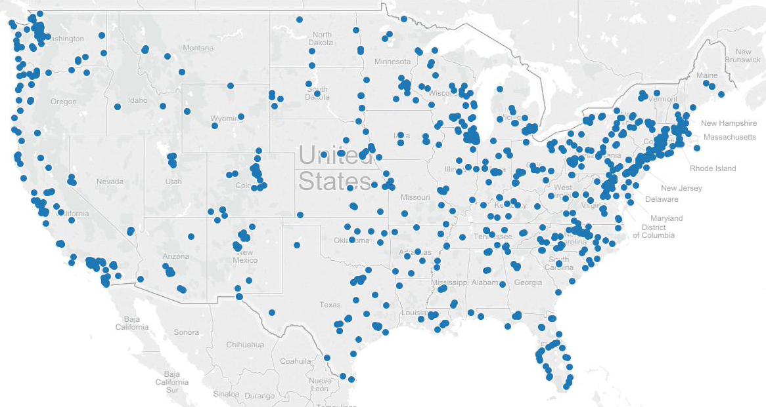
Distribution of all venues that projects used to reach audiences in 2014 (across 81 projects)

Slide 12
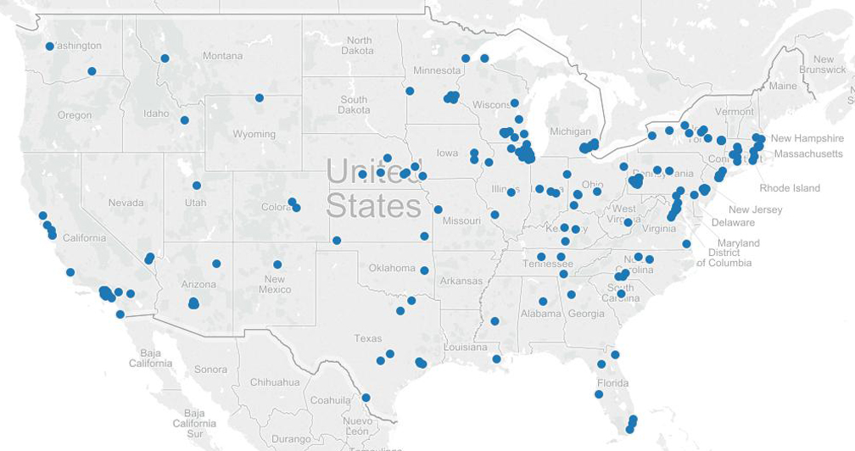
Distribution of museums that projects used to reach audiences in 2014

Slide 13
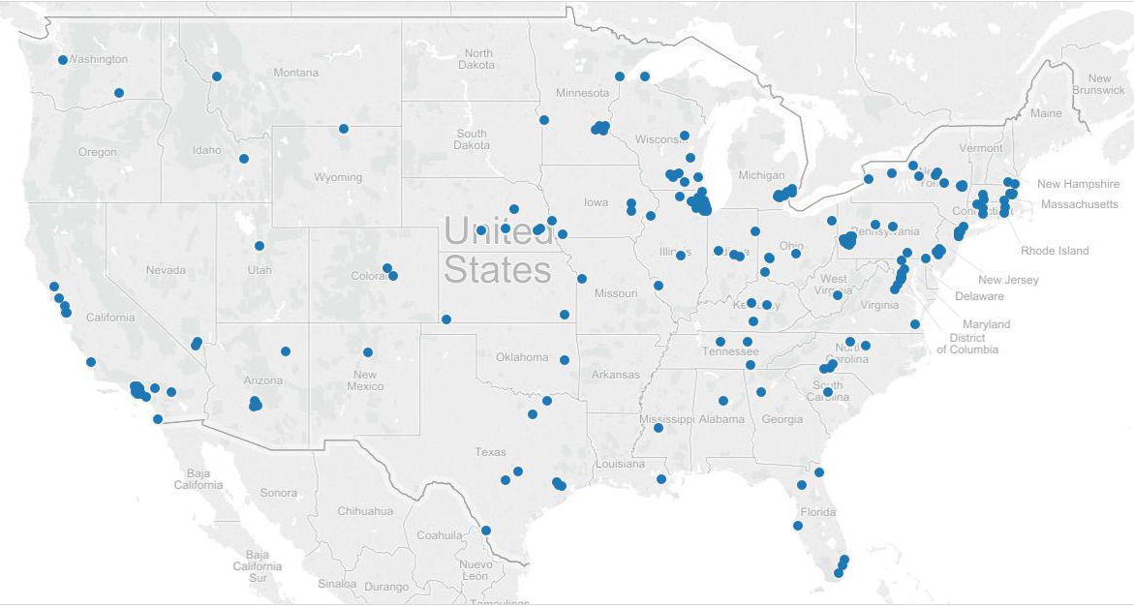
Distribution of K-12 schools that projects used to reach audiences in 2014

Slide 14
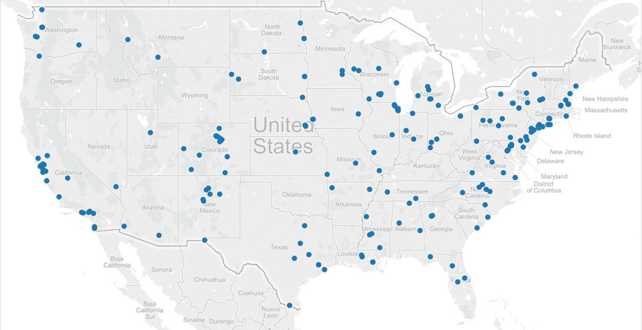
Distribution of colleges and universities that projects used to reach audiences in 2014

Slide 15
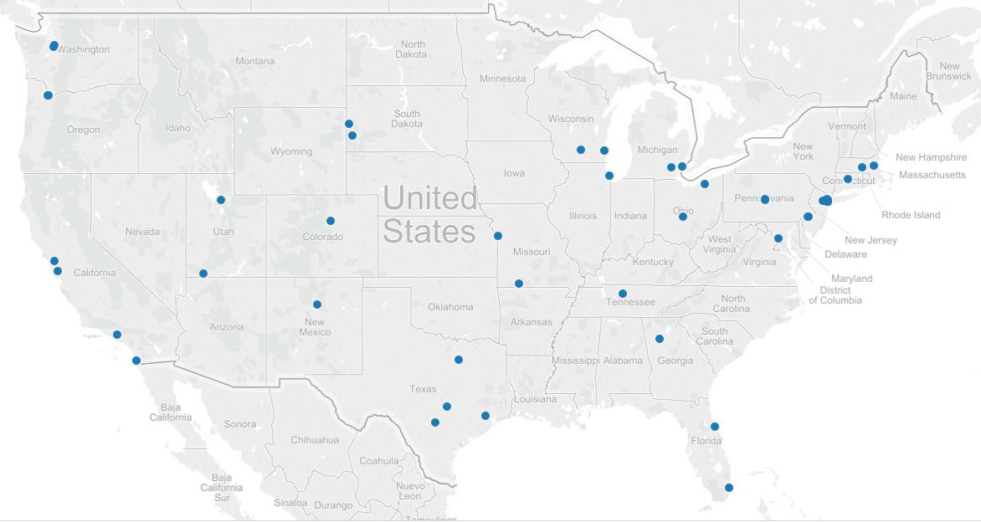
Distribution of theaters that projects used to reach audiences in 2014

Slide 16
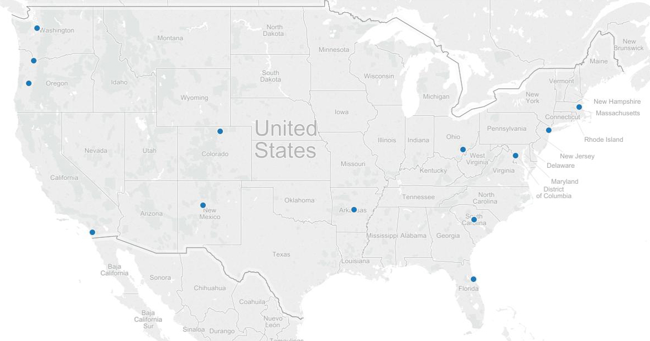
Distribution of restaurants that projects used to reach audiences in 2014

Slide 17
Public Audience Deliverables

Slide 18
Types of deliverables projects used to reach public audiences in 2014 (77 projects)

Slide 19
Deliverables used to reach public audiences in 2014 (207 deliverables across 77 projects)
Deliverable type | Number | Percent
Museum exhibit (permanent, temporary, or traveling) | 23 | 11.1
After school or summer program for youth | 23 | 11.1
Group-oriented program | 13 | 6.3
Demonstration/activity kit/guide | 13 | 6.3
Game | 9 | 4.3
Festival or other one-time/annual event | 8 | 3.9
Video segment/clip/program/series | 7 | 3.4
Television segment/episode/program/series | 5 | 2.4

Slide 20
Total and median number of public audience members reached in 2014 (unduplicated count, 48 projects)
Deliverable type | Total | Median
Total number of users/listeners/viewers | 28,168,656 | 590
Audio or video | 19,493,707 | 350
Games and information communication technologies | 2,407,476 | 5,331
Exhibits | 1,248,427 | 94,951
Program, events, and activities | 281,355 | 128
Resource materials and information sharing | 155,423 | 600
Infrastructure development | 128,256 | 462
Project website | 2,454,012 | 57,614

Slide 21
Age groups projects anticipated targeting with their public audience deliverables (FY 2006-14; 264 projects)

Slide 22
Audiences underrepresented in STEM that projects anticipated targeting with their public audience deliverables (FY 2006-14; 264 projects)

Slide 23
Strategies projects anticipated using to target a specific audience (FY 2009-14; 163 projects)
Strategy | Number | Percent
Outreach or marketing to specific target audiences | 72 | 44.2
Content developed for a specific audience | 60 | 36.8
Activity specifically designed to be accessible to a target audience (e.g., lack access to necessary equipment) | 39 | 23.9
Outreach to school groups/programs | 38 | 23.3
Location allows for easy targeting to specific audiences | 30 | 18.4
Involve people from target groups in project design | 29 | 17.8

Slide 24
Impacts that projects anticipated for their public audiences (FY 2006-14; 227 projects)

Slide 25
Professional Audience Deliverables

Slide 26
Types of deliverables that projects used to reach professional audiences in FY 2014 (66 projects)

Slide 27
Professional audiences that projects reached in 2014 (66 projects)

Slide 28
Total and median number of professional participants reached in 2014 (unduplicated count, 40 projects)
Deliverable type | Total | Median
Total number of professional audience participants | 88,463 | 50
Informal educators | 61,687 | 30
Pre-K‒12 teachers | 9,534 | 23
Post-secondary instructors | 2,772 | 25
Exhibit designers | 1,086 | 7
Scientists, engineers and/or scientists | 696 | 18
Staff at after-school and youth programs | 590 | 12
Staff at community programs | 198 | 9

Slide 29
Impacts that projects anticipated for their professional audiences (FY 2006-14; 202 projects)

Slide 30
Research Questions

Slide 31
Distribution of research questions across AISL award types (33 projects funded in FY 2013 and FY 2014)

Slide 32
Sample research questions
What student-level, teacher-level, and school-level factors contribute to or inhibit students gains in SEP mastery and/or their interest in science?
How are instructional practices in STEM summer programs related to perceptions of challenge, relevance, learning, and affect for participating youth?
Are situational (momentary) interest and engagement in STEM activities across several weeks associated with changes in: (a) individual (sustained) interest in STEM; (b) a STEM self-concept; and (c) future goals and aspirations related to STEM?
How are evaluations used in relation to Science Festivals and how does evaluation use change within the context of a community of practice that creates its own multisite evaluation?
What contextual factors influence the nature of staff-facilitated family mathematical discourse?
How can family mathematical discourse and socio-mathematical norms at exhibits be operationalized and measured?

Slide 33
Study designs to be used to examine research questions (141 research questions across 33 projects)

Slide 34
Exploring the OPMS Database

Slide 35
We can parse the database to explore…
The number of people who visited AISL-supported museum exhibits in a given year
  The outcomes associated with museum exhibits (and the evidence that those outcomes were attained)
  The number of AISL-funded museum projects that target youth—and the strategies being used to engage this population
The number of AISL projects focusing on biological sciences in after school programs
The extent to which post-secondary institutions are partnering with museums or exhibit designers
The outcomes associated with AISL projects employing gaming strategies with persons living in rural communities

Slide 36
The database can also be used to examine narrative information for a given project type
Progress made addressing a given research question
Project outcomes
Strategies used to reach international audiences and engage specific target groups
Project implementation
Lessons learned
Factors affecting implementation of a given deliverable
Most significant accomplishment
Evidence that a public/professional audience outcome was met
Factors hindering attainment of a specific outcome
How project advanced knowledge about ISE or a field
Significant innovations that occurred as a result of the project
Future plans

Slide 37
Gary Silverstein
(301) 251-2244
GarySilverstein@westat.com
Ashley Simpkins
(240) 453-2687
AshleySimpkins@westat.com

