Slide 1

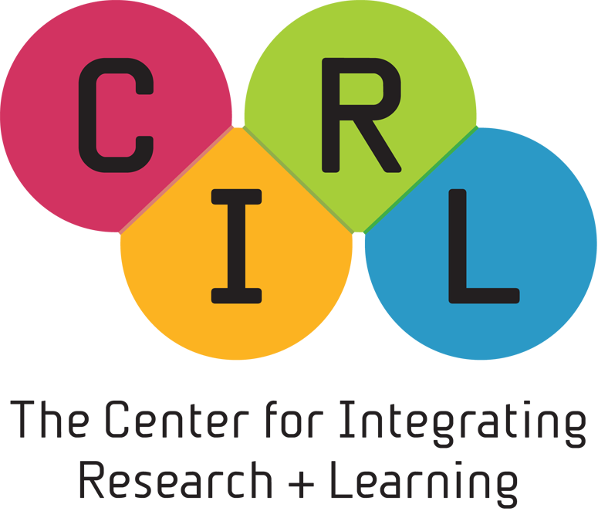

Longitudinal Tracking of K-16 Participants in STEM Education Programs at a National Lab
2013 MRS Spring Meeting, San Francisco, CA
Presentation Date: April 2, 2013
Presentation Time: 2:15 PM to 3:15 PM
Roxanne Hughes, Ph.D.
Director, Center for Integrating Research & Learning
National High Magnetic Field Laboratory
hughes@magnet.fsu.edu
1800 E. Paul Dirac Drive
Tallahassee, FL 32310
850-645-8179
Fax: 850-644-5818
http://education.magnet.fsu.edu
This study was funded in part by the National Science Foundation Division of Materials Research through DMR 0654118 and by the National Science Foundation through Cooperative Agreement EEC 0812121

Slide 2

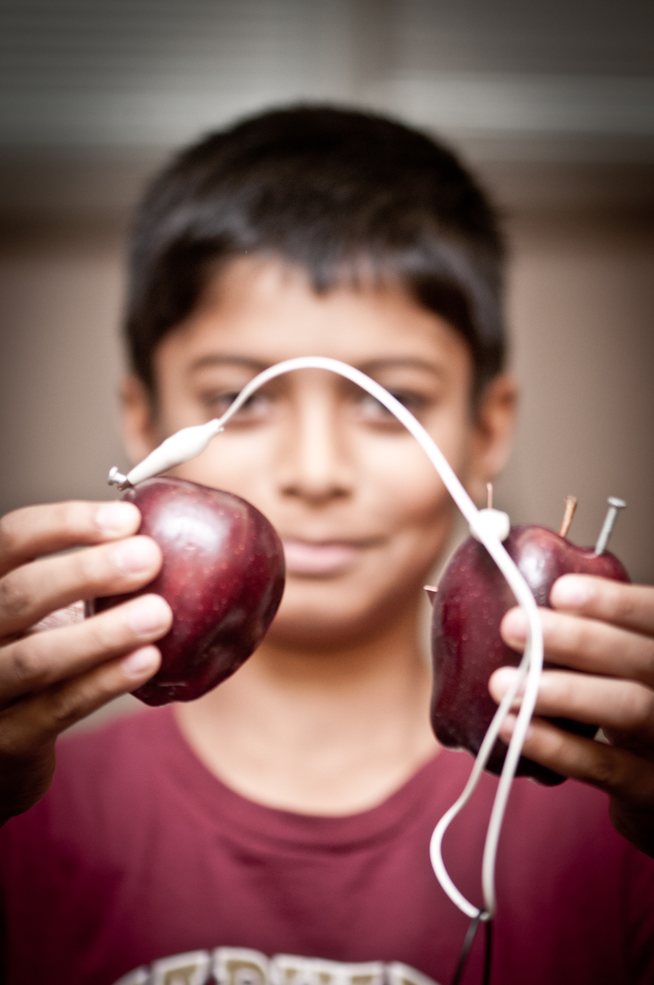
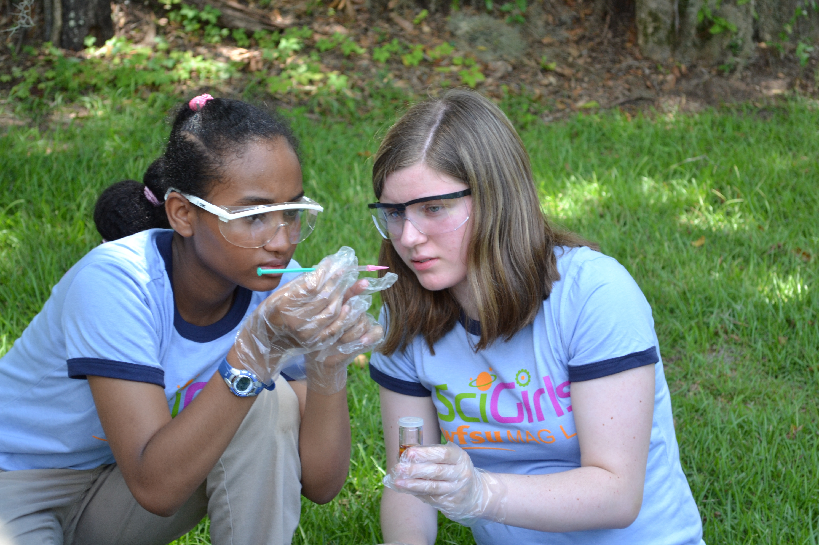
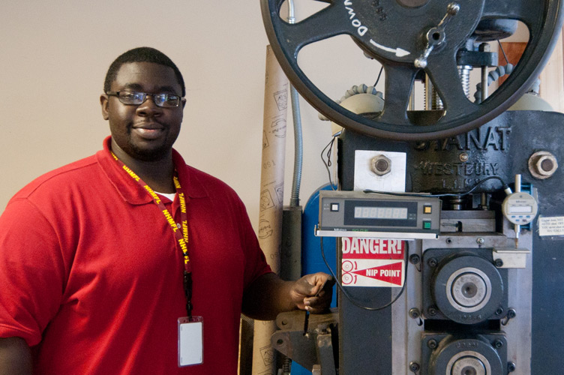
Our Mission Statement
“To expand scientific literacy and to encourage interest in and the pursuit of scientific studies among educators and students of all ages through connections between the Magnet Lab and the NSF, the community of Tallahassee, the State of Florida and the nation.”

Slide 3

Educational Programming
Our mission — to expand scientific literacy and to encourage interest in the pursuit of scientific studies — has become more specifically targeted to encourage K-16 students to pursue STEM career paths.
Few labs have the staff to research the effects of these programs, therefore studies that can provide longitudinal data on the impact of informal STEM outreach programs would be useful to national labs and their funders.
K-12 STUDENTS
• Classroom Outreach
• Mentorships (MS)
• Internships (HS)
• Summer Programs
• Young Scholars
• Web Activities
K-12 TEACHERS
• Classroom Outreach
• MagLab Educators Club
• Teacher Workshops
• Research Experiences
• Web & Social Media
THE PUBLIC
• B&N Science Nights
• Senior Center
• MagLab Tours
• Science Cafés
• Web & Social Media
UNDERGRADS +
• Internships
• Research Experiences
• Outreach Opportunities
• Grad/Post Doc Mentoring

Slide 4

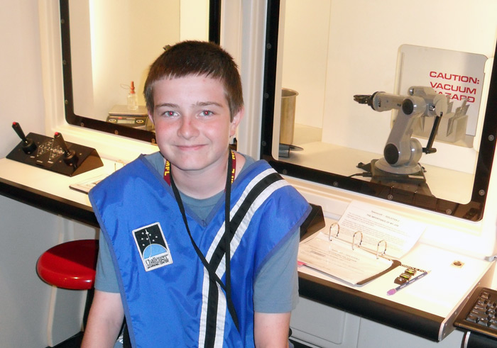
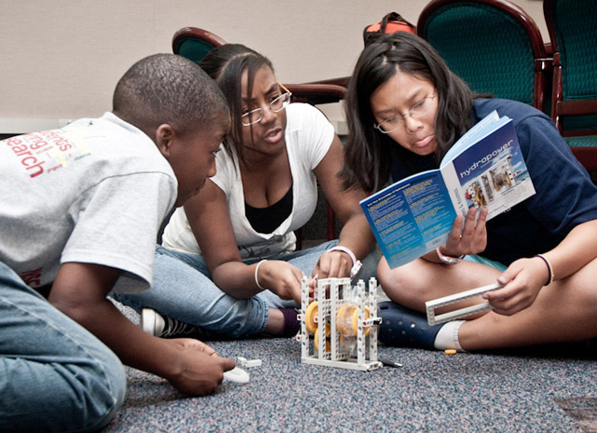
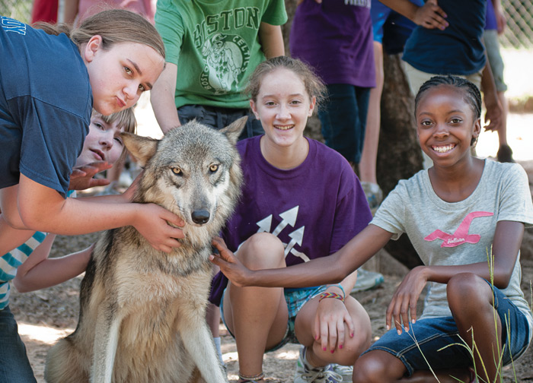
Summer Programs
SUMMER PROGRAMS
MagLab Summer Camp
(Middle-schoolers for 2 weeks)
Renewable Energy Camp
(Middle-schoolers for 1 week)
Nanotechnology Workshop
(Middle-schoolers for 1 week)
SciGirls 1
(Middle-schoolers for 2 weeks)
SciGirls 2
(High-schoolers for 2 weeks)
Young Scholars Program
(High-schoolers for 5 weeks)
Summer camps
Diversity
  350 students reached (82% female)
  24% African American
  6% Hispanic
  .6% Native American

Slide 5
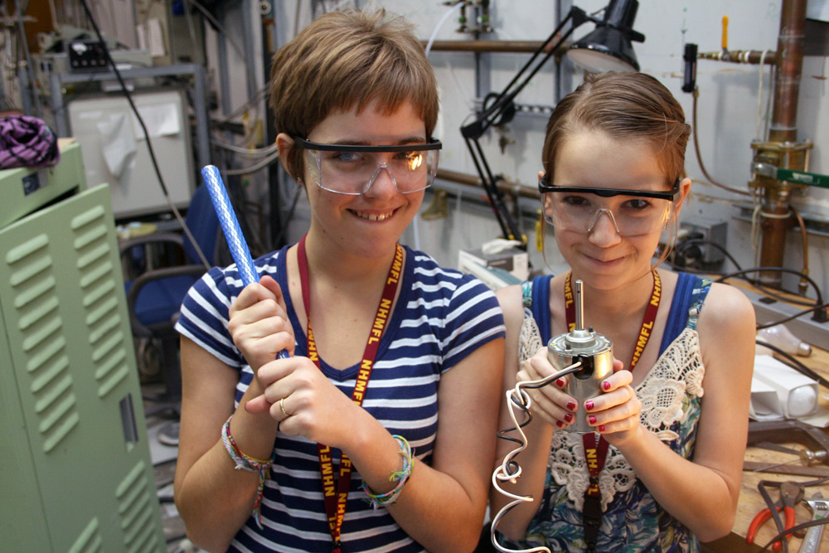
SciGirls
Since 2006, 166 young women have participated in the SciGirls program. Of those, 48 participated in the program for two summers (29%)
144 participants are eligible for the Longitudinal Cohort (2006-2011 participants)
Of those, 60 have responded to one or more of the following longitudinal instruments: 2009 survey, 2012 survey, 2011 interviews.
Demographics for All Campers (N=144)
Demographics for Longitudinal Cohort (n=60)
Race/ ethnicity | N | Percent of total
African Americans | 26 | 18%
Asian Americans | 13 | 9%
Hispanic | 7 | 5%
White | 98 | 68%
Race/ Ethnicity | N in cohort | % of Follow up cohort
African Americans | 10 | 17%
Asian Americans | 3 | 5%
Hispanic | 1 | 2%
White | 46 | 77%

Slide 6
Quantitative Evidence
Effects of Camp | Tally | Percent of Total (n=60)
Increased interest in STEM | 60 | 100%
Learned about real-world applications of STEM | 26 | 43%
Learned about STEM careers | 20 | 33%
Motivated to take more advanced STEM courses | 9 | 15%
Motivated to pursue STEM careers | 8 | 13%
Improved concept that women can be successful in STEM | 7 | 12%
Increased confidence in STEM abilities | 6 | 10%
Participated in and learned about collaboration as it relates to STEM | 6 | 10%
Increased understanding of STEM | 4 | 7%

Slide 7
Qualitative Evidence
Reason for Increased STEM interest | Quote
Better understanding of STEM fields’ relevance to their lives (43%) | - SciGirls allowed me to view different fields of science and explained in depth the complexity of science in everyday life. (2012 response from 2007/08 camper). - SciGirls reinforced my interest in science and it also made me realize that there was more to science than just what was taught in the school room” (2009 response from 2007/08 camper).
Better understanding of STEM careers (40%) | - I learned what types of sciences I really enjoyed, and what types I really didn't care for. Some areas surprised me: for example, I am totally into botany, of all things. We learned about the biology of the pine ecosystem, and I was fascinated! When we went to [a local water way] and took a nature hike, that solidified the deal. I ended up walking with one of the counselors who also loved botany, and she told me all about the different plants as we walked along. SciGirls also opened me up to science jobs that I'd never thought about before -- like a forester, an Antarctic researcher... The list goes on and on.(2009 response from 2006/07 camper) - It just helped me know that this is what I want to do. Ever since I was 10 I wanted to be a chemist, but I didn't know any girl chemists. I met women in science thru SciGirls and I can now see they aren't just geeky women in white coats (2009 response from 2008 camper).
Better understanding of the process of STEM (10%) | - SciGirls opened me more into the world of science. It taught me that science isn't just mixing chemicals together in a lab. You have to know what you're doing, be good at it, and always have the mindset that there might be an answer to your solution and that your solution could be different from someone else’s. In other words, science isn't about finding the truth about something, it's about understanding why something happens (2012 response from a 2009/10 camper).

Slide 8
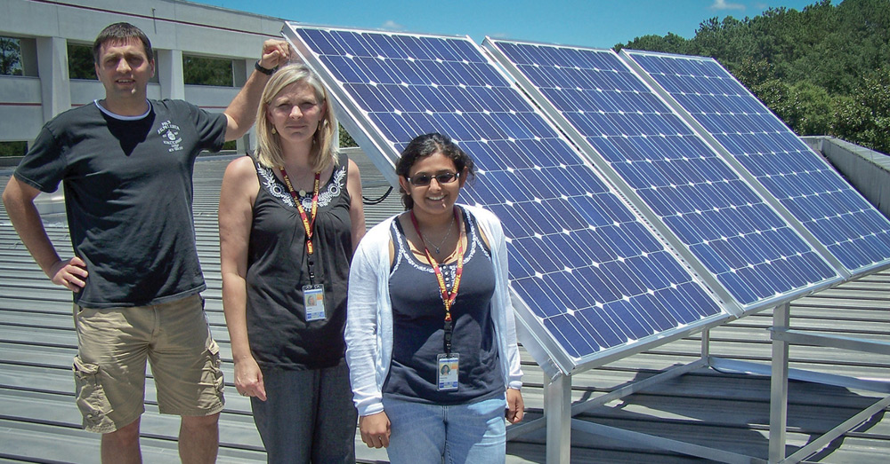
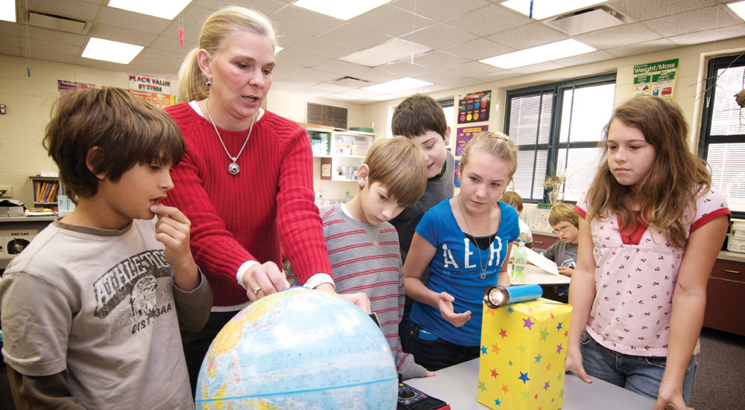
RET Program
Six-week summer program
Provides exposure to authentic scientific research and professional development related to science education
148 teachers have participated since 1998 reaching more than 1,000 students K-12 annually
  40% no longer have current contact information
  Of the remaining 88, 60% (N=53) have responded
Since 2001, 30% of these teachers come from Title I schools

Slide 9
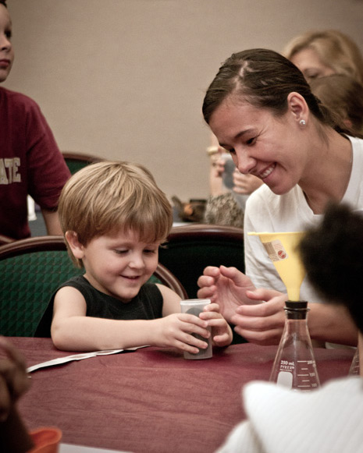
Role of Professional Development (RET) on Teacher Leadership
Of the teachers who responded to the survey, almost half of these teachers came from Title I schools (45% n=24). And 87% are still teaching (n=46), with the remaining 13% working in an educational related field but not in a classroom.
Teachers mentioned two ways in which their participation in RET (a form of professional development) affected their trajectories as leaders
Increased content knowledge
  Most of them chose to pursue the RET program not because of a lack of understanding of science teaching but because they wanted to learn more about authentic scientific research. What these participants realized is that they also found out more about science content along with their broader understanding of scientific research.
Increased confidence
  This translated into confidence in their science teaching since they could
  answer student and colleague questions related to authentic research.
  This also led them to attend more professional development programs, specifically more RET programs

Slide 10
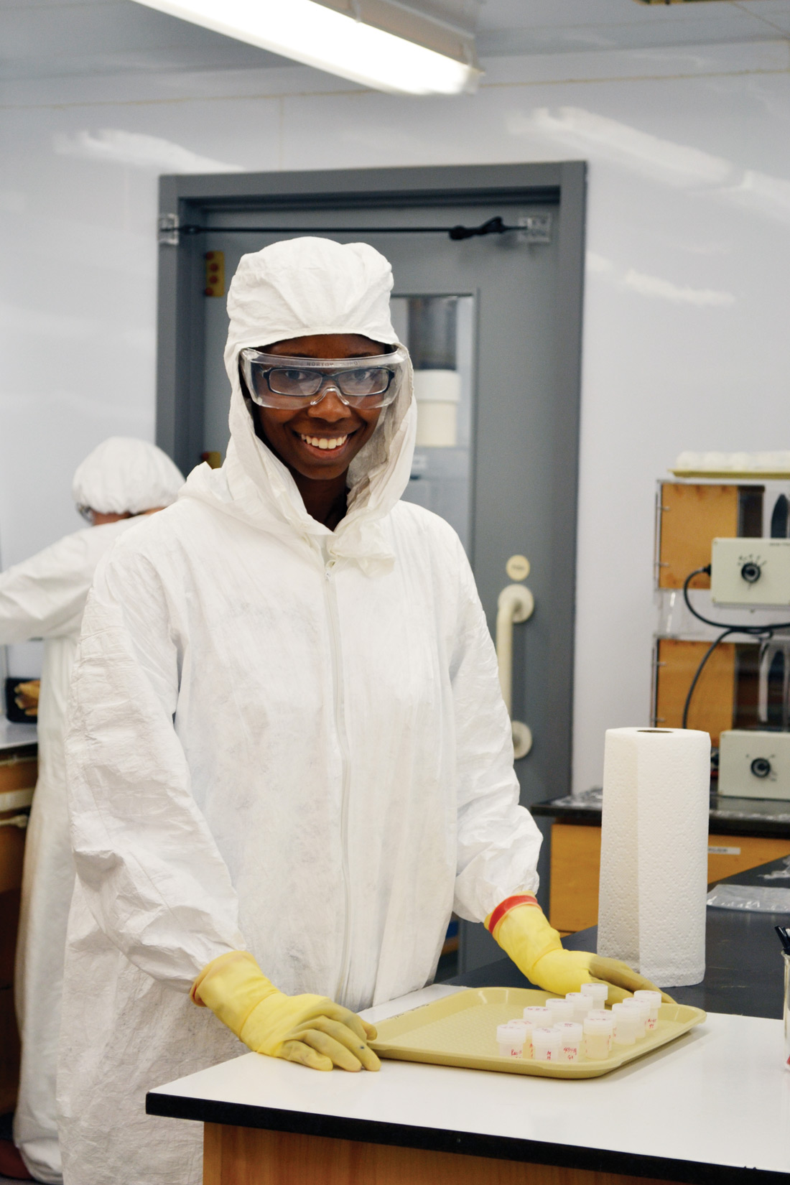
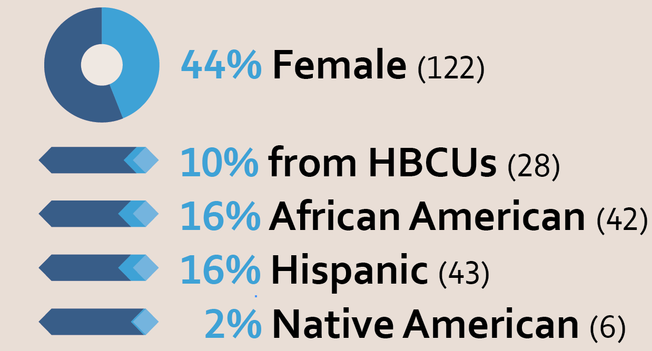
REU Program
Eight-week program matching
highly qualified undergrads in STEM fields with MagLab scientists.
Since 1999, 249 students have participated.
DIVERSITY STATS

Slide 11
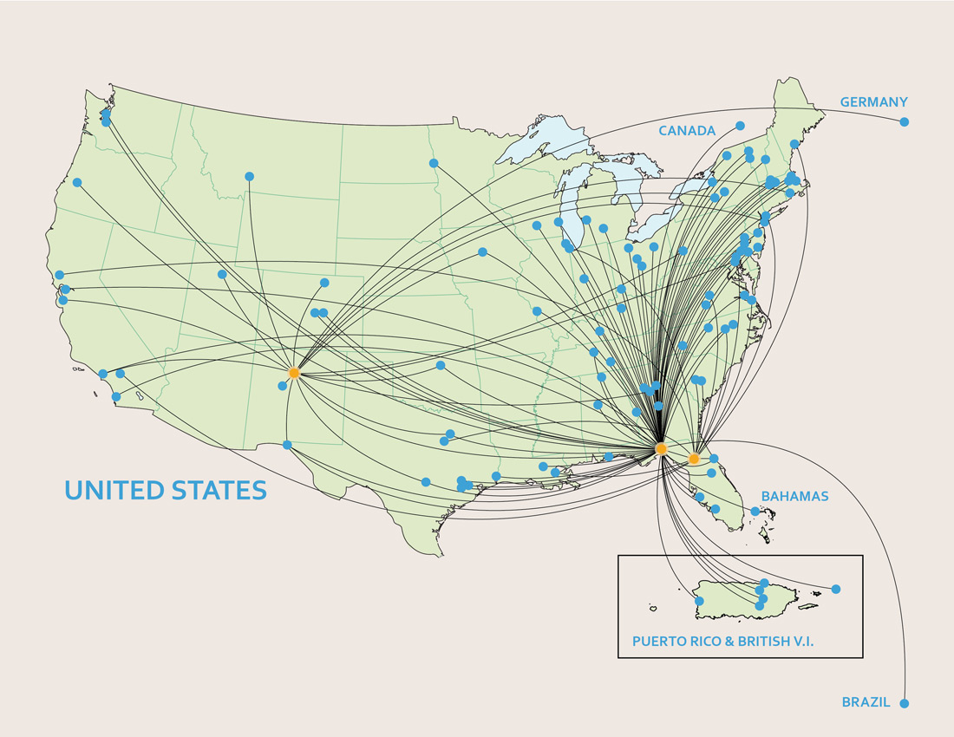
REU Home Institutions
Come from colleges and
universities all over the United States, with 2% (5)
coming from outside the US. Only 13% (37) come
from a school in the immediate vicinity of a MagLab site.

Slide 12
Undergraduate Demographics
249 former REUs that we have been tracking from 1999 – 2012.
Undergraduate Institutions Represented (n= 249*)
  Research Institutions = 73%
  Non-research institutions = 27%
  Women’s colleges = 2.4%
  HBCUs = 8.8%
  HSIs = 11.2%
Undergraduate STEM degrees (144 have completed a bachelors in STEM)
  49% in physical sciences
  32% in Engineering
  16% in Natural Sciences
  3% in Math/Computer Science
*189 of the 249 have been part of the longitudinal tracking.

Slide 13
Degree attainment
Current academic or professional status (n=189):
  38.6% are working in STEM professions
  3.7% are working in non-STEM professions
  25.4% are pursing Doctoral degrees in a STEM field
  8.5% are pursing Masters degrees in a STEM field
  23.8% are undergraduates pursing a bachelors in a STEM field
Degree obtainment:
  Approximately 87% of our former REU participants have enrolled in a graduate program after completing their Bachelor of Science degree(s).
  81 completed graduate degrees in STEM fields
    48 Masters degrees
    33 Doctoral degrees
    only 5 non-STEM graduate degrees.

Slide 14
Demographics for Underrepresented Minorities in Science (URMs)
  URMs in science include women, Native Americans, Hispanics, and African Americans.
  URM participants enrolled in a graduate program after completing their Bachelor of Science degree(s):
    81.3% of female participants
    61.5% of Hispanic American participants
    50.0% of African American participants
    40.0% of Native American participants

Slide 15
Gender and Racial Demographics
Female REU participants enrolled in a graduate program (n=52):
  34.6% completed Doctoral degrees
  38.7% completed Master’s degrees
  38.5% are currently pursuing Doctoral degrees
  9.6% are currently pursuing Master’s degrees
Graduate school enrollment by disciplinary field:
  42.3% Natural Sciences
  30.8% in Physical Sciences
  26.9% in Engineering disciplines
  3.8% in non-STEM fields
(2 Female REU participants completed both a Doctoral and Master’s degree)
African American REU participants enrolled in a graduate program (n=10):
  20.0% completed Doctoral degrees
  50.0% completed Master’s degrees
  1 African American REU participant currently pursuing a Doctoral degree
  20.0% are currently pursuing Master’s degrees
Graduate school enrollment by disciplinary field:
  50.0% in Engineering disciplines
  20.0% Natural Sciences
  10.0% in Physical Sciences
  10.0% in Mathematics
  10.0% in non-STEM fields

Slide 16
Racial and Ethnic Demographics
Hispanic American REU participants enrolled in a graduate program (n=16):
  1 Hispanic American participant completed a Doctoral degree
  43.8% completed Master’s degrees
  50.0% are currently pursuing Doctoral degrees
  18.8% are currently pursuing Master’s degrees
Graduate school enrollment by disciplinary field:
  43.8% in Physical Sciences
  31.3% Natural Sciences
  25.0% in Engineering disciplines
  6.3% in Mathematics
  6.3% in non-STEM fields
(1 Hispanic REU participant completed both a Doctoral and Master’s degree)
Native American REU participants enrolled in a graduate program (n=2):
  1 Native American participant has completed a Doctoral degree
  1 Native American participant has completed a Master’s degree
Graduate school enrollment by disciplinary field:
  Both (100%) in Natural Sciences

Slide 17
Data Analysis
Difference in independent means test (T-tests)
  Gender
    Marginally more women completed Doctoral degrees (t=1.813; p=0.085)
  Research vs. non-research institutions
    Significantly more students from research institutions had publications stemming from their REU experience (t=2.308; p=0.022) than students from non-research institutions
  One of our graduate students is exploring these results more fully in his dissertation

Slide 18
Longitudinal Tracking of K-16 Participants in STEM Education Programs at a National Lab
CIRL grad students conduct research and evaluation on all of our programming
These efforts allow CIRL to stand out among other informal education agencies housed within National Labs
The results of these trajectory studies indicate that exposing K-16 students and K-12 teachers to authentic scientific research within a national laboratory is beneficial to STEM persistence for students and STEM teaching for teachers.

