Slide 1


2016 AISL PI Meeting
Keynote Presentation
March 1, 2016
W. James Lewis
Deputy Assistant Director,
Education and Human Resources
U.S. National Science Foundation

Slide 2







National Science Foundation
National Science Board
Office of the Director
France A. Córdova
Biological Sciences
Geosciences
Computer and Information Science and Engineering
Mathematical and Physical Sciences
Engineering
Social, Behavioral, and Economic Sciences
Education and Human Resources

Slide 3
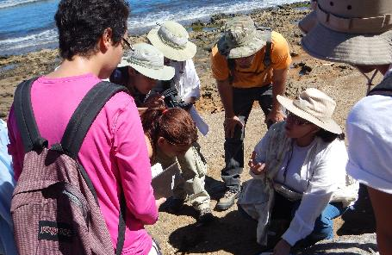
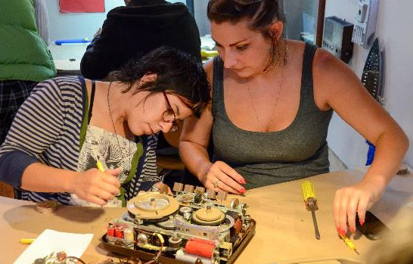
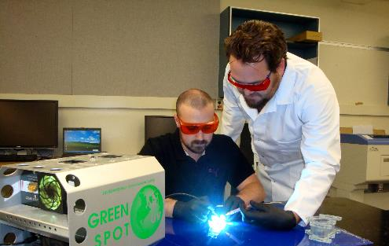
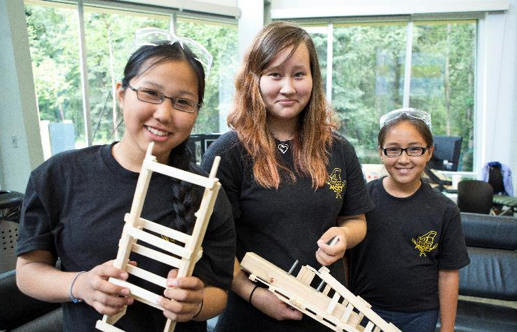
Investments in STEM education continue to grow.
Notes:
FY 2017 NSF Budget Request: $7,964M
FY 2017 EHR Budget Request: $952.86M
Change over EHR FY 2016 estimate: $72.86M or + 8.3%

Slide 4



NSF continues to advance research where discoveries begin.
12,000
awards funded
Funds research in all S&E disciplines
$8
billion
FY 2017 request
2,000
NSF-funded
Institutions
Funds STEM
education and workforce
50,000
proposals
350,000
NSF-supported researchers
217
Nobel Prize winners
Other than the FY 2017 request, numbers shown are based on FY 2015 activities.

Slide 5
EHR is committed to an inclusive STEM enterprise for science and society.
831
awards funded
Funds all S&E disciplines
million
FY 2017 request
$953
650
EHR-funded
Institutions
Funds research in STEM
education
4,243
proposals
147,000
EHR-supported researchers
42 former GRF fellows received Nobel Prize
Other than the FY 2017 request, numbers shown are based on FY 2015 activities.

Slide 6
















Committee on Science, Technology, Engineering, and Mathematics Education (CoSTEM)

Slide 7

Federal Science, Technology, Engineering, and Mathematics (STEM) Education 5-Year Strategic Plan
Priority Areas
P-12 STEM education
Undergraduate education
Graduate education
Broadening participation
Public engagement
Coordination and evaluation

Slide 8
Public and Youth Engagement in STEM Interagency Working Group Strategies
Federal investments in engagement that draw explicitly on the scientific, technological, and engineering assets (e.g., facilities, scientific and engineering staff, instruments, data, and federally-managed public lands and waterways) of the Federal Government, where feasible, to provide authentic experiences;
Federal engagement investments that support the integration of STEM into existing school readiness and after-school programs with significant local, regional, or national reach; and
Federal engagement investments that contribute to improving empirical understanding of how engagement in authentic STEM experiences relates to improved student learning or interest outcomes.

Slide 9
AISL priorities
Build a stronger knowledge-base for the field
Stimulate education innovations
Be strategic with respect to advancement of the field
Develop strong collaborations that foster robust professional communities beyond the interests of a particular institution and its immediate locale
Notes:
Questions and responses from Al DeSena
Considering research in informal STEM education, are there any gaps in the research that we would like the AISL community to think on before the next deadline? We don’t think of this as gaps per se.
We are hoping that the collaborations of researchers and practitioners will continue to be strengthened. There has been some discussion of the need for longitudinal research. Note that CAISE has an initiative on Research and Practice and some of the Tuesday sessions are specifically about research and evaluation.

Slide 10
Resources for the AISL community
Community for Advancing Discovery Research in STEM Education (CADRE): A resource network serving the Discovery Research in PreK-12 program.
MSPnet: An electronic community that serves NSF's Math and Science Partnerships (MSP) and STEM + Computing Partnerships (STEM+C).
Center for Advancement of Informal Science Education (CAISE): InformalScience.org is a central portal operated by CAISE.
Notes:
Notes from Al DeSena
How might we invite the AISL community to share their thoughts on what NSF/EHR is doing to help connect them to their work?
Al: Emphasize the role of the DRL resource centers (including CAISE) as opportunities for the field and NSF to communicate more deeply.

Slide 11
Priorities for Informal STEM and NSF
Broader impacts: The potential to benefit society and contribute to the achievement of specific, desired societal outcomes.
Broadening participation initiatives: The Advancing Informal STEM Learning (AISL) program allows expanded emphasis on broadening participation through informal learning environments, including out-of-classroom experiences.
Notes:
Al: Jim should mention the importance of NSF-wide broader impacts and broadening participation initiatives as areas where informal STEM learning has and should continue to play an important role.

Slide 12
Funding opportunities for informal science education in EHR
Discovery Research PreK-12 (DRK-12)
Innovative Technology Experiences for Students and Teachers (ITEST)
Promoting Research and Innovation in Methodologies for Evaluation (PRIME)
EHR Core Research (ECR)
Science Learning+
STEM+Computing Partnerships (STEM+C)
Faculty Early Career Development Program (CAREER)
Cyberlearning and Future Learning Technologies (Cyberlearning)
Notes:
Opportunities highlighted in the Monday, Feb. 29 presentation- where AISL staff will be highlighting funding opportunities around NSF for informal STEM learning. Jim needs to know that we are already doing this, but it will be very top level, so if he wants, he can pick up on any one of those points. We are trying to position informal STEM learning across the agency, not just the AISL program.

Slide 13
Funding opportunities for informal science education across NSF
Dear Colleague Letters
Integrated NSF Support Promoting Interdisciplinary Research and Education (INSPIRE)
Support for Engaging Students and the Public in Polar Research
Stimulating Research Related to the Science of Broadening Participation
Stimulating Research on Effective Strategies in Undergraduate STEM Education at Two-Year Hispanic Serving Institutions
Notes:
Opportunities highlighted in the Monday, Feb. 29 presentation- where AISL staff will be highlighting funding opportunities around NSF for informal STEM learning. Jim needs to know that we are already doing this, but it will be very top level, so if he wants, he can pick up on any one of those points. We are trying to position informal STEM learning across the agency, not just the AISL program.

Slide 14
NSF 15-120: Dear Colleague Letter: Supporting Research Advances in Smart and Connected Communities
Through this Dear Colleague Letter (DCL), NSF aims to accelerate fundamental understanding and stimulate basic research on frameworks that integrate and operate on data from multiple sources and at multiple temporal and spatial scales, new sociotechnical systems that are interconnected and interdependent, and new technologies for innovative applications and services to enable more livable, workable, sustainable, and connected communities
Participating Directorates: Computer and Information Science and Engineering, Education and Human Resources, Engineering, Geosciences, and Social, Behavioral, and Economic Sciences
Notes:
From E. Kelly’s Slides on Smart and Connected cities
A S&CC problem is a complex problem that motivates some community (e.g., tribe, region, town, rural group, city, megacity) to design, deploy and evaluate an intervention that has potential to ameliorate the problem.
The attempted intervention is “smart and connected” to the extent that it takes advantage of emerging nested systems of cyber physical sensors, Internet of Things, wearable technologies, mobile systems, etc. for which a compelling case can be made that the intervention is likely to lead to efficiencies in resources, powerful models and solutions, and advances in science and engineering knowledge and practices, and STEM education research.
The intervention is also “smart and connected” to the extent that it involves the creative engagement of one or more communities and their distributed human and social capital (e.g., tribal representatives, city planners, and the resources of formal and informal education, including citizen science, and the maker movement).

Slide 15
NSF 15-086: Dear Colleague Letter: Enabling the Future of Making to Catalyze New Approaches in STEM Learning and Innovation
NSF is uniquely positioned to leverage the burgeoning Maker Movement and the large network of Maker spaces.
Making has the potential to: catalyze new possibilities for formal and informal STEM learning, stimulate innovative design thinking, increase retention and broaden participation in STEM, empower citizen engineers, and enable new ways of STEM learning and design thinking that will enrich the U.S. innovation ecosystem.
Participating Directorates: Education and Human Resources, Engineering, and Computer and Information Science and Engineering
Notes:
From DCL: Specifically, NSF challenges and encourages the community to submit innovative proposals for fundamental research or the integration of research and education that:
Elucidate the processes and potential benefits of learning, e.g. design thinking, in the Maker context;
Leverage Making to develop and test its role in improving the effectiveness of formal and informal learning pathways for increasing retention and broadening participation in STEM for students and faculty;
Explore new ideas and models of formal and informal STEM learning by leveraging existing knowledge in Making;
Investigate and test effectiveness of new approaches to design and innovation enabled by Maker spaces and practices;
Enable new tools and knowledge for design and prototyping across all disciplines that can significantly increase Making capabilities; and
Further the understanding of innovation processes from prototypes through their transition to products that have greater societal and economic impact through enhanced marketability and large-scale market adoption.

Slide 16
NSF INCLUDES 16-544
NSF Inclusion across the Nation of Communities of Learners of
Underrepresented Discoverers in
Engineering and Science
Goal: Support innovative models, networks, partnerships, and research that enable the U.S. science and engineering workforce to thrive by ensuring that women, blacks, Hispanics, and people with disabilities are represented in percentages comparable to their representation in the U.S. population.

Slide 17
NSF INCLUDES
I.e., improve the preparation, increase the participation, and ensure the contributions of individuals from groups that traditionally have been underrepresented in the STEM enterprise.
We seek measureable progress at the national level and the ability to scale the concepts of diversity and inclusion.
Strategy: Collective Impact

Slide 18
NSF INCLUDES
2016
Design and Development Launch Pilots
  30-40 2-year awards at $300,000 each
Deadlines:
  Preproposal April 15,2016
    (required and binding)
  Full proposal: June 24, 2016

Slide 19
NSF INCLUDES
Design and Development Launch Pilots will:
Test the feasibility of developing a full-scale plan beyond the pilot including sustainability
  Year 1: Refine collective commitment to common set of objectives
  Year 2: Implement and report the results of the collective-impact style approach
In FY 2017, share goals and plans via live or virtual gatherings

Slide 20
NSF INCLUDES
2017
NSF INCLUDES Alliances
  3-5 Awards
  5 Year Awards
  Up to $2,500,000 per year
  You must be part of a Launch Pilot to submit an Alliance proposal.
NSF INCLUDES Backbone Organization
and another round of
Design and Development Launch Pilots

Slide 21
NSF INCLUDES
The solicitation includes three examples of national Broadening Participation objectives that may have potential for scaling nationally and require regional implementation including this example:
Creating preK-20+ pathways in major urban centers involving universities, community colleges, local schools, surrounding communities, not-for-profits, museums and science centers, local businesses and industries, and science-rich institutions designed to enable success for students from underrepresented and low socio-economic groups.

Slide 22
NSF Agency Priority Goal: Invest Strategically in Public Participation in STEM Research
Build the capacity of the Nation to solve research challenges and improve learning by investing strategically in crowdsourcing and other forms of public participation in science, technology, engineering, and mathematics research (PPSR).
By September 30, 2017 NSF will implement mechanisms to expand and deepen the engagement of the public in STEM research.
Co-leads
  Joan Ferrini-Mundy, Assistant Director for Education and Human Resources
  Jim Kurose, Assistant Director for Computer and Information Science and Engineering

Slide 23
Thank you
Questions and discussion

