Slide 1

ASTC 2014
Submitting Competitive NSF Proposals
Advancing Informal STEM Learning (AISL)
AISL SOLICITATION
(NSF 14-555)

Slide 2

SESSION AGENDA
  Overview of EHR/NSF - Bob
  AISL Program Overview & Solicitation - Bob
  Project Types - Al
  Preparing Competitive Proposals - Wyn
  Review Process & Merit Review Criteria - Al
  Other NSF Programs & Resources Program Contact Information - Bob
  Questions

Slide 3
  EHR Vision
  A healthy and vital national science, technology, engineering, and mathematics (STEM) education enterprise.
  EHR Mission
  To support research and development on STEM education and learning and to engage and grow a diverse, STEM-literate citizenry ready to advance the frontiers of science and innovate for society.
  Focus Areas
  Learning and Learning Environments
  Broadening Participation
  Workforce Development

Slide 4
Research, Development, and Model-Building for STEM Learning
Investments where questions inform development and model-building and, in turn, model building and development give rise to new questions.
Development & Model-Building
Research

Slide 5
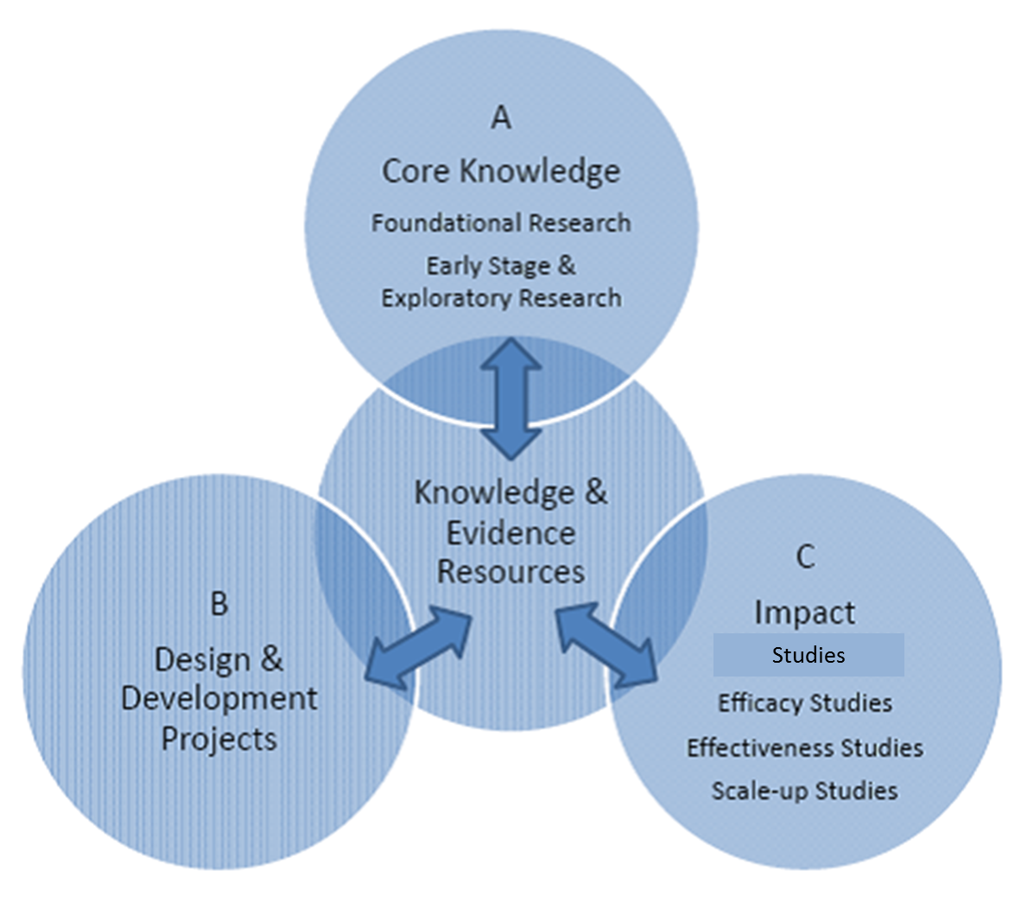
Common Guidelines for Education Research and Development

Slide 6
Rationale for AISL Projects
Connecting individuals with the building blocks they need to understand cutting-edge science and their world
Building theoretical and empirical foundations for effective learning in informal environments
Furthering the assessment of such learning
Supporting the use of innovative methods to address questions of importance to those who work in informal STEM learning settings

Slide 7
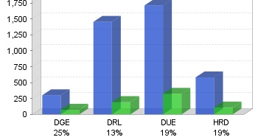
EHR Funding Rates for FY 2014

Slide 8
AISL
Program Overview &
Solicitation
Notes:
Bob
We’ll start with on overview of the AISL program and solicitation.

Slide 9
AISL Program
Advancing – Innovative projects that advance the field through building knowledge via innovative approaches and research.
Informal – Out-of-School learning that makes learning lifelong, life wide, & life deep.
STEM – Not just focused on science, but all of NSF-funded STEM.
Learning – Learning outcomes include: interest, engagement, motivation, behavior, identity, persistence, understanding, awareness, knowledge, and use of STEM content and practices, and 21st century skills.

Slide 10
AISL SOLICITATION (#14-555)
IMPORTANT DATES
Proposal deadlines:
November 14, 2014 (FY 2015)
  New solicitation in 2015
  READ THE SOLICITATION MULTIPLE TIMES!!!

Slide 11
Project
Types

Slide 12
Pathways
Exploratory development work or feasibility studies
Should lead to field-advancing proposals of other project types
Should produce evidence, findings and/or deliverables that form basis for further work
Should state how project informs future work & advances field
Funding up to $300,000 (duration up to 2 years)

Slide 13
Research in Service to Practice
Advances knowledge & provides evidence base for practice
Primary focus on research questions
Qualitative or quantitative data (evidence) and involve range of techniques
Can also be syntheses or meta-analyses
Includes literature review & detailed research plan
Researchers and practitioners are close collaborators
Funding from $300K to $2 million for 2-5 years

Slide 14
Innovations in Development
Builds knowledge through the development of innovative products
Builds on evidence from prior practice & research
Describes an explicit theory & logic model/theory of action
Includes plan & process for design, development & implementation
Includes plan for knowledge building through research and/or evaluation
Funding: $500K to $3 million for 2-5 years

Slide 15
Broad Implementation
Expands models, programs, technologies, assessment or other advances that have documented record of success
Expands reach: age, gender, geography, etc.
Includes plan & process for design, development, & implementation
Builds knowledge through research and/or evaluation
Funding $500K to $3 million for 2-5 years

Slide 16
SCIENCE LEARNING+
An international partnership
  Established by NSF, UK-based Wellcome Trust, and UK Economic and Social Research Council
  In collaboration with the MacArthur Foundation, the Gordon and Betty More Foundation, and the Noyce Foundation
Science Learning+ funding (up to $14.4mil) will support research in out-of-school learning
  Research into how learning happens outside the classroom
  Exploration of effective practice
  Building the evidence base

Slide 17
SCIENCE LEARNNG+ (2)
Objectives
  Strengthen the research and knowledge base
  Bridge the practice – research gap:
  Share knowledge and experience:
Funding priorities
  Understanding learning
  Engagement in STEM
  Skills development
  Equity, diversity, and access to informal learning settings
  Measurement of outcomes

Slide 18
Conferences, Symposia & Workshops
Relate to AISL program goals
Focus on development of communities of practice, field-advancing practice, assessments, & research agendas
Proposals request >$50,000, due on deadline
Proposals up to $50,000 may be submitted at any time

Slide 19
Preparing & Submitting Competitive Proposals
Grant Proposal Guide http://www.nsf.gov/publications/pub_summ.jsp?ods_key=gpg

Slide 20
2014 AISL Funding
$37.9 million funding for new awards:
13 Pathways
5 Research in Service to Practice
11 Innovations in Development
5 Broad Implementation
7 Other: RAPID, EAGER, conference, co-funds

Slide 21
Preparing to Submit a Proposal
www.fastlane.nsf.gov; 1-800-673-6188
(7 AM to 9 PM Eastern Time • M-F)
Submit early
Required sections
IRB
Check your proposal for compliance—just hit the button in Fastlane

Slide 22
Project Summary
  First Sentence
  Type of Proposal: Pathways, etc.
  Overview
  Describe type of activity that will result, objectives & methods
  Intellectual Merit and Broader Impacts
  Must include separate statements on each of these two NSB criteria

Slide 23
Project Description (Narrative)
Identify project type in first sentence
Cover the following in the project description:
  Project Rationale
  Project Design
  Dissemination Plan
  Evaluation & External Review
  Management Plan

Slide 24
Project Rationale
Describe primary goals, hypotheses, models, products or research questions
Explain how the project builds on prior research and practice
Explain how the project is innovative and builds knowledge for the field
Describe STEM content
Discuss results of prior NSF support and how (where relevant) it informs the design of the proposed project
Notes:
Bob
Rationale for project is critical
Key points to make: importance of goals/research, how it is innovative, builds on prior research/practice
In terms of prior NSF support, if you haven’t previously had NSF support, that’s fine. If you have, this question asks you to document the work you’ve done and its implications/impacts. In other words, are you worth investing in again? Do you do what you said you will do—and do you do it well? [this question was asked later for clarification]

Slide 25
Project Design
Describe project deliverables
Describe measure of learning outcomes for target audiences and how they were selected
Identify public and/or professional target audiences & how they will be reached
Describe (if relevant) how the project will broaden participation for underrepresented groups
Describe how the project will generate knowledge, including questions, methods, instruments & analysis
Describe project impact on informal STEM
Notes:
Bob
Key points to make: specific description of deliverables and learning outcomes for target audiences, how they will be reached (including underrepresented/underserved audiences), how the project will generate new knowledge and impact the informal ed STEM field.
Put your detailed knowledge building plans in this section, whether research or summative evaluation.

Slide 26
Dissemination Plan
Describe the key elements of a creative communications plan to disseminate project products and/or findings to the general public, researchers, policy makers, and practitioners
Required to share design, findings, and products with the CAISE: informalscience.org website.
Notes:
Bob
Clarify--- this section for describing how you will communicate/disseminate your FINDINGS about your project (new knowledge)—not just distributing your products.
Training--PD
Requirement to share on CASIE

Slide 27
Evaluation & External Review
Evaluation & External Review processes are to:
  Ensure that projects get appropriate, rigorous input throughout the life of the project so that the research and development components of the project are actively improved as a result.
  Ensure there is accountability: The federal govt is funding you to enact as specific project—Did you end up doing what you said you would do? What was the quality of your work?
  All projects must build knowledge—advance the field through research, evaluation, or a hybrid. There are as many permutations as there are proposals.
Most critically, each PI team figure out what makes the most sense to meet their project’s goals and include a clear design and description of an evaluation and external review plan in their proposal.

Slide 28
Evaluation & External Review
Examples:
Research studies: External critical review:
  Improve quality of research process
  Did project meet goals? Level of quality?
  The research results = knowledge building component.
Development components: Evaluation:
  Iteratively improves design and implementation (internal or external evaluator)
  Did project meet goals? Level of quality?
  If evaluation is the knowledge building component, then summative evaluation needed. If research is the knowledge building component, see above.

Slide 29
Management Plan
Describe the project leadership team, other members of the project team & advisory board, and how their combination of expertise is appropriate
Describe the management plan for how the team and partners will work collaboratively to achieve project goals
Provide a workplan for key project tasks/deliverables

Slide 30
Supplementary Documents
Brief letters of commitment or cooperation
Summaries of formative & summative evaluation findings of prior work (2 page max.)
Additional details of logic model, theory of action and evaluation plans (5 page total max.)
Additional 30 pages (max.) of supporting info, such as media scripts, exhibit sketches, etc.
Data Management Plan
Post Doc Mentoring Plan

Slide 31
Budget
Should be consistent with level of work – you do not have to request the maximum!
Two months salary: No more than two months of salary for senior personnel on all NSF grants without a justification
Indirect cost rates: Set by the institution and auditors and is non-negotiable.
No cost sharing.

Slide 32
Avoid Ineligible Expenses
Capital or operating expenses
Major or office equipment
Vehicles
Undergraduate tuition
Paid advertising
Admission fees
Publications and curricula as the primary deliverable

Slide 33
Review
Process &
Merit Review
Criteria

Slide 34
Proposal Review Process
Proposals are reviewed in review panel discussions that include a range of external experts (e.g. educational researchers, content experts, educators, developers).
Reviewers rates each proposal as Excellent, Very Good, Good, Fair or Poor
PIs receive reviews (3-4), panel summaries, and comments from POs, which are advisory.
Programs have meetings where most final recommendations are determined.
Funding is often negotiated through questions and, sometimes, project & budget revisions.

Slide 35
Merit Review Criteria
Intellectual Merit and Broader Impact
1. What is the potential for the proposed activity to:
a. advance knowledge and understanding within its own field or
across different fields (Intellectual Merit); and
b. benefit society or advance desired societal outcomes
(Broader Impacts)?
2. To what extent do the proposed activities suggest and explore creative, original, or potentially transformative concepts?
3. Is the plan for carrying out the proposed activities well-reasoned, well-organized, and based on a sound rationale? Does the plan incorporate a mechanism to assess success?
4. How well qualified is the individual, team, or institution to conduct the proposed activities?
5. Are there adequate resources available to the PI (either at the home institution or through collaborations) to carry out the proposed activities?

Slide 36
NSF 13-126 - Joint effort between NSF and the Institute for Education Sciences at the U.S. Department of Education http://www.nsf.gov/pubs/2013/nsf13126/nsf13126.pdf?WT.mc_id=USNSF_124
NSF 13-127 - Set of FAQs http://www.nsf.gov/pubs/2013/nsf13127/nsf13127.pdf
Common Guidelines
for Educational
Research and
Development

Slide 37
Goals of the Common Guidelines Project
Improve the quality and pace of findings from education research and development proposals
Develop an education infrastructure that supports more rapid and efficient knowledge development
Aid NSF and ED in making informed choices about where to invest scarce research and development dollars
Provide clarity for the field (and within the two agencies)
A good reference for framing research & eval.

Slide 38
CAISE: InformalScience.org
InformalScience.org website: redesigned and now compiles a large number of previously independent websites.
Resource for potential AISL PIs: http://informalscience.org/nsf-aisl (or just look for NSF AISL in the upper middle on the informalscience.org homepage).
Midway down the NSF AISL page is Resources for Working with National Science Foundation Support, which includes many evaluation resources as does http://informalscience.org/evaluation/evaluation-resources
There are other proposal related resources, including on the CAISE-website at http://informalscience.org/about/informal-science-education/resources.

Slide 39
NSF Resources for PIs
What has AISL funded? http://www.nsf.gov/awardsearch/
  Put in AISL to see the vast range of what has recently been funded or just click on the link from the AISL webpage: http://www.nsf.gov/funding/pgm_summ.jsp?pims_id=504793
  Also try key words related to your proposal topic/area; there are many search options to explore
NSF Grant Proposal Guide (GPG) is very helpful as are FAQs: http://www.nsf.gov/publications/pub_summ.jsp?ods_key=gpg
  IRB and other information is also on this page.

Slide 40
Final Suggestions
  Submit early
  Spell check; Check grammar & punctuation (professional editor?)
  Talk early with Program Officers (POs); email DRLAISL@nsf.gov
  Post Submission: Take follow-up questions from NSF seriously

Slide 41
Reviewing for NSF?
Interested in Serving as A Reviewer:
Experience the Proposal Review Process
Serve as a Content/Field Expert
Contribute To Funding Decisions & Field Advancement
Additional questions or interest in in being a reviewer:
DRLAISL@nsf.gov
41

Slide 42
OTHER
PROGRAMS

Slide 43

Other DRL Programs…
EHR Core
ITEST
DRK-12
43

Slide 44
EHR Core Research
Foundational research:
STEM Learning
Learning Environments
Workforce Dev.
Broadening Participation
Core Research proposals: $1.5 million/up to 5 years
Capacity Building: $300K/up to 3 years
Deadlines: Feb. 3, 2015

Slide 45
ITEST: Innovative Technology Experiences for Students/Teachers
R & D of innovative models for K-12 to engage in STEM & ICT
Must include students & can include teachers
Resource Center: http://www2.edc.org/itestlrc/default.asp
Target date:
Nov. 6, 2014
Notes:
The ITEST program fund R&D for innovative models in K-12, Information, Communication, Technology

Slide 46
DRK-12
Can focus on single discipline or be cross-disciplinary
Three types of projects: Exploratory; Full Design & Development; Conferences & Workshops
Resource Center:
http://cadrek12.org/nsf-dr-k-12
New Program Announcement in 2015.
Project framed around research question
Innovative resources, models & tools
Four strands: Assessment, Learning, Teaching & Implementation Research
Can draw from practice in formal & informal learning
Notes:
And the DRK 12 program as the name indicates builds knowledge and develops innovative resources, models and tools primarily for K-12 learners and teachers.

Slide 47
More EHR Programs…
PRIME
CAREER
ATE
Cyberlearning
STEM-C
EHR Programs/Dates: http://www.nsf.gov/funding/pgm_list.jsp?org=EHR
47

