Slide 1
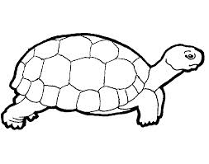
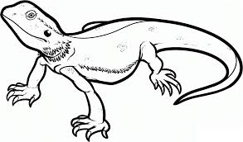
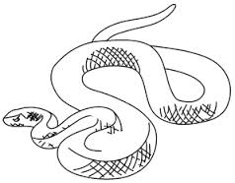
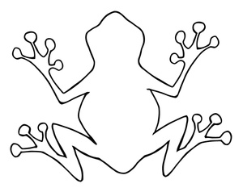
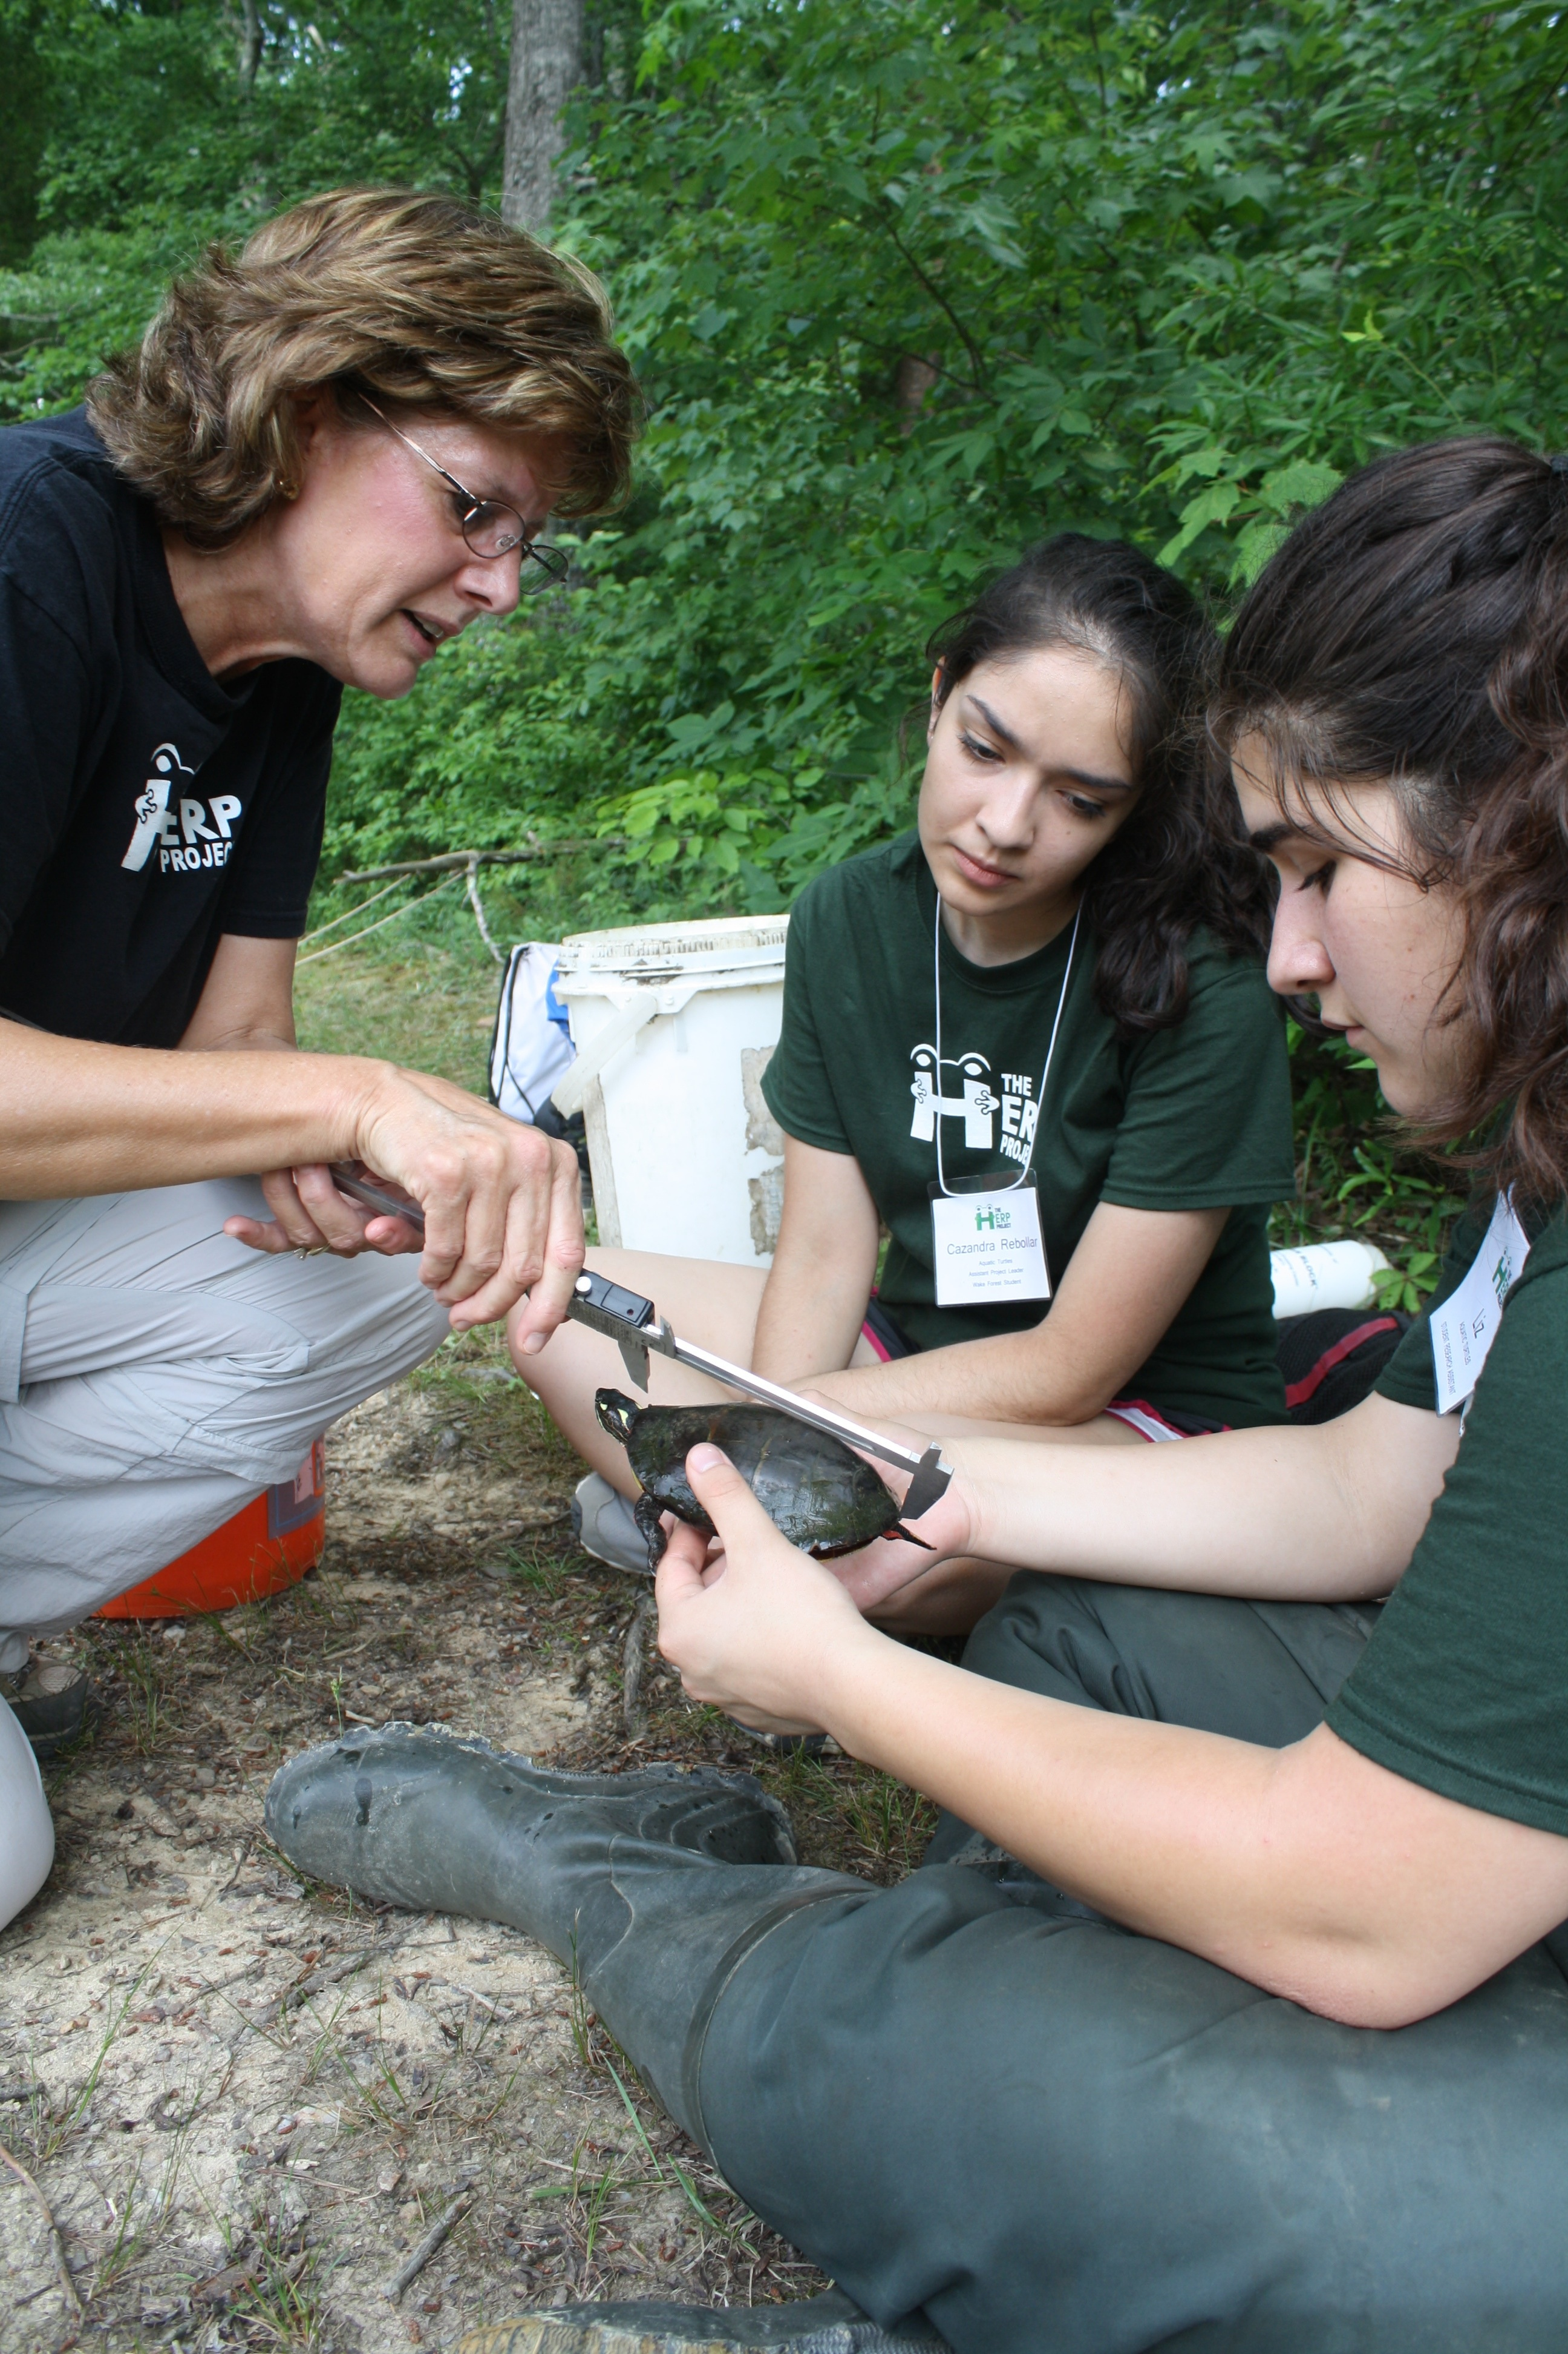
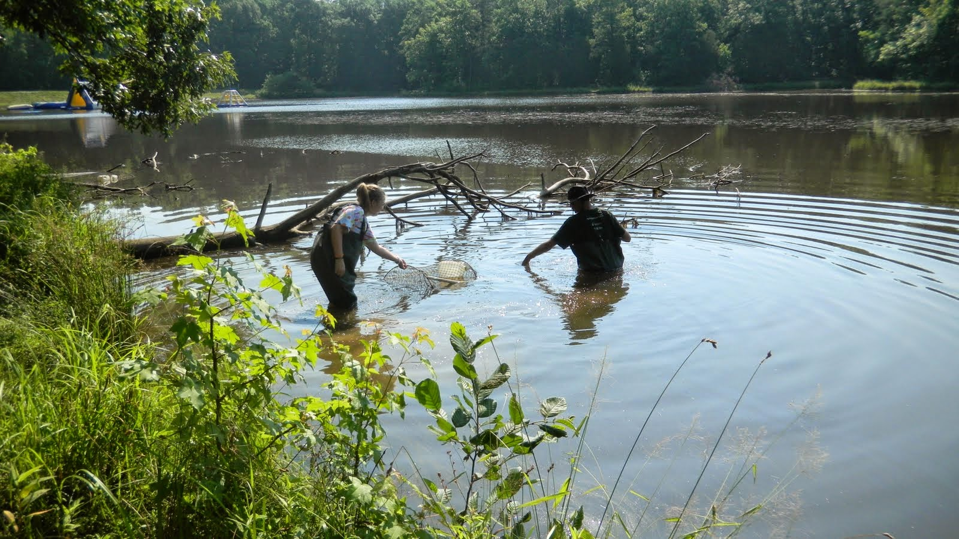
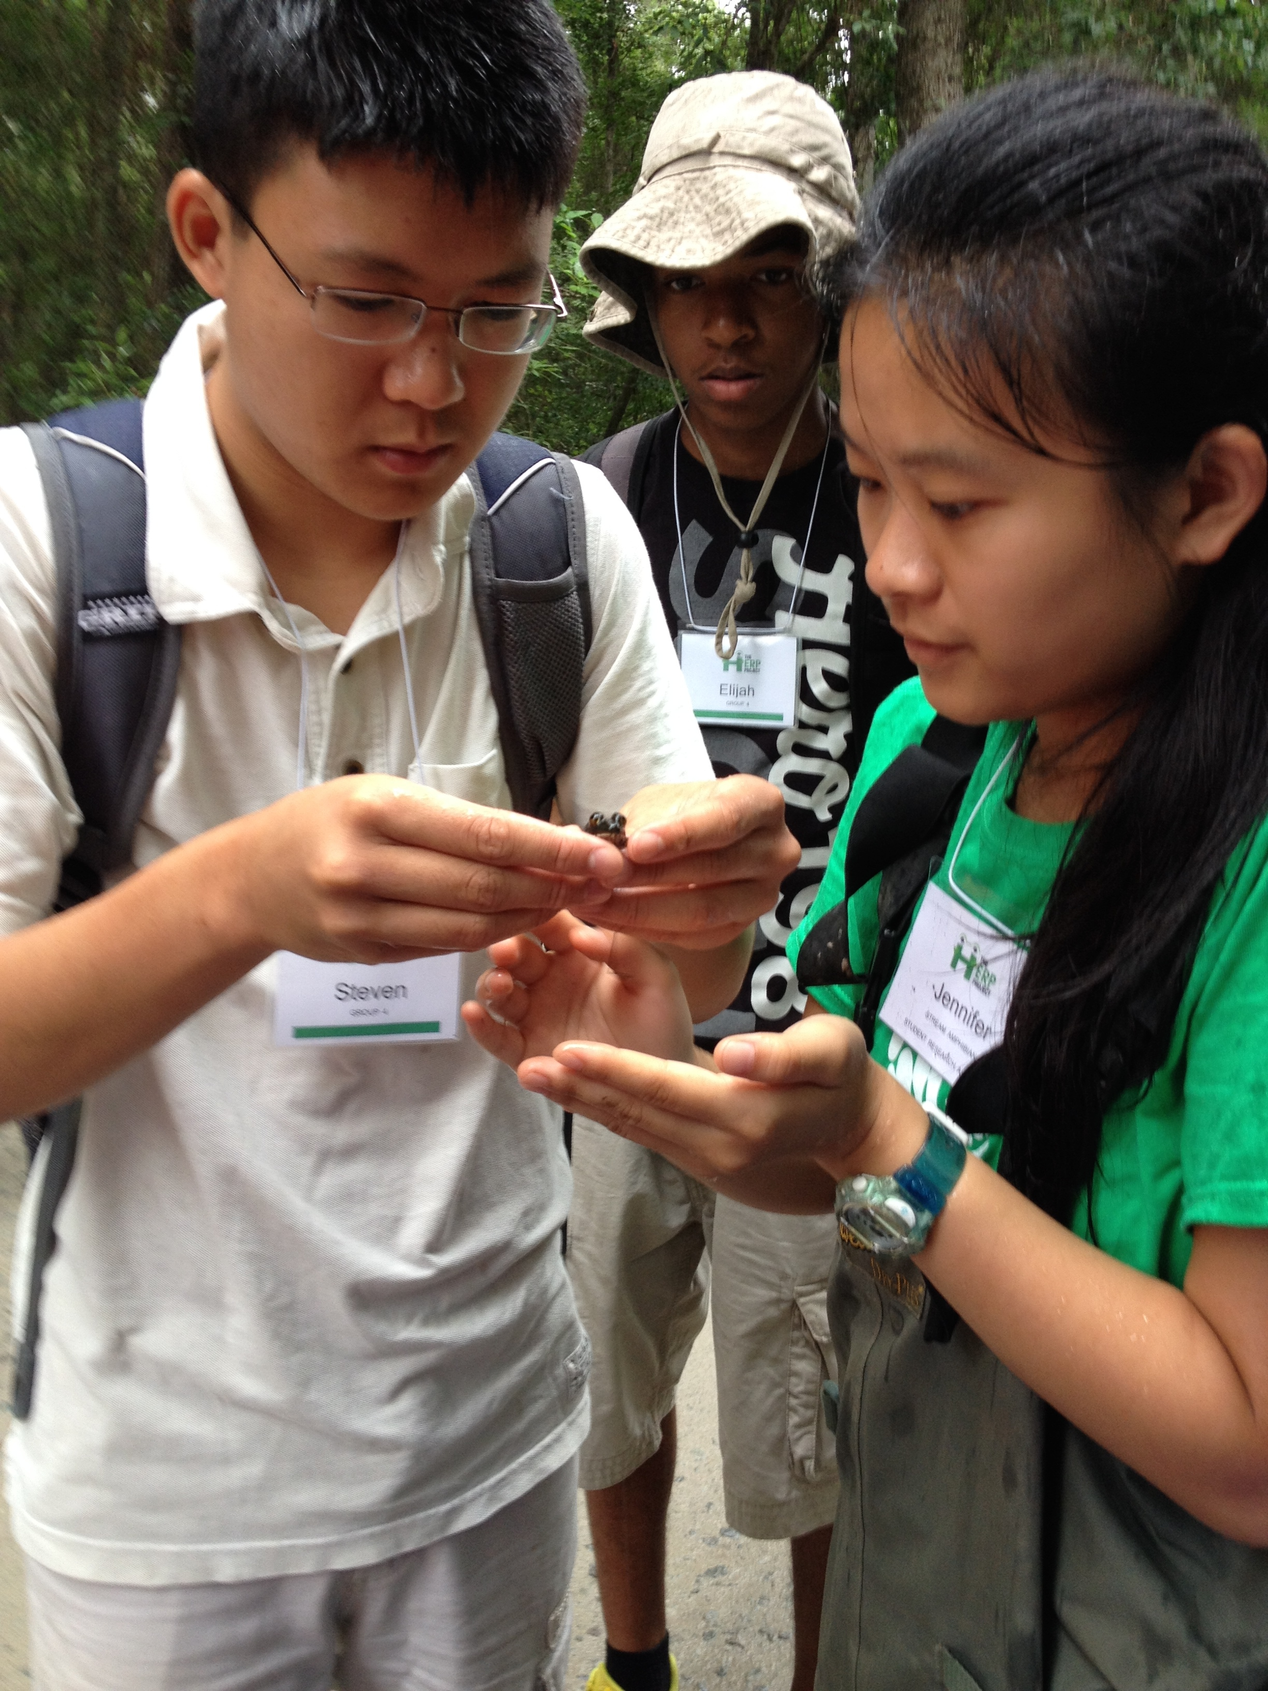
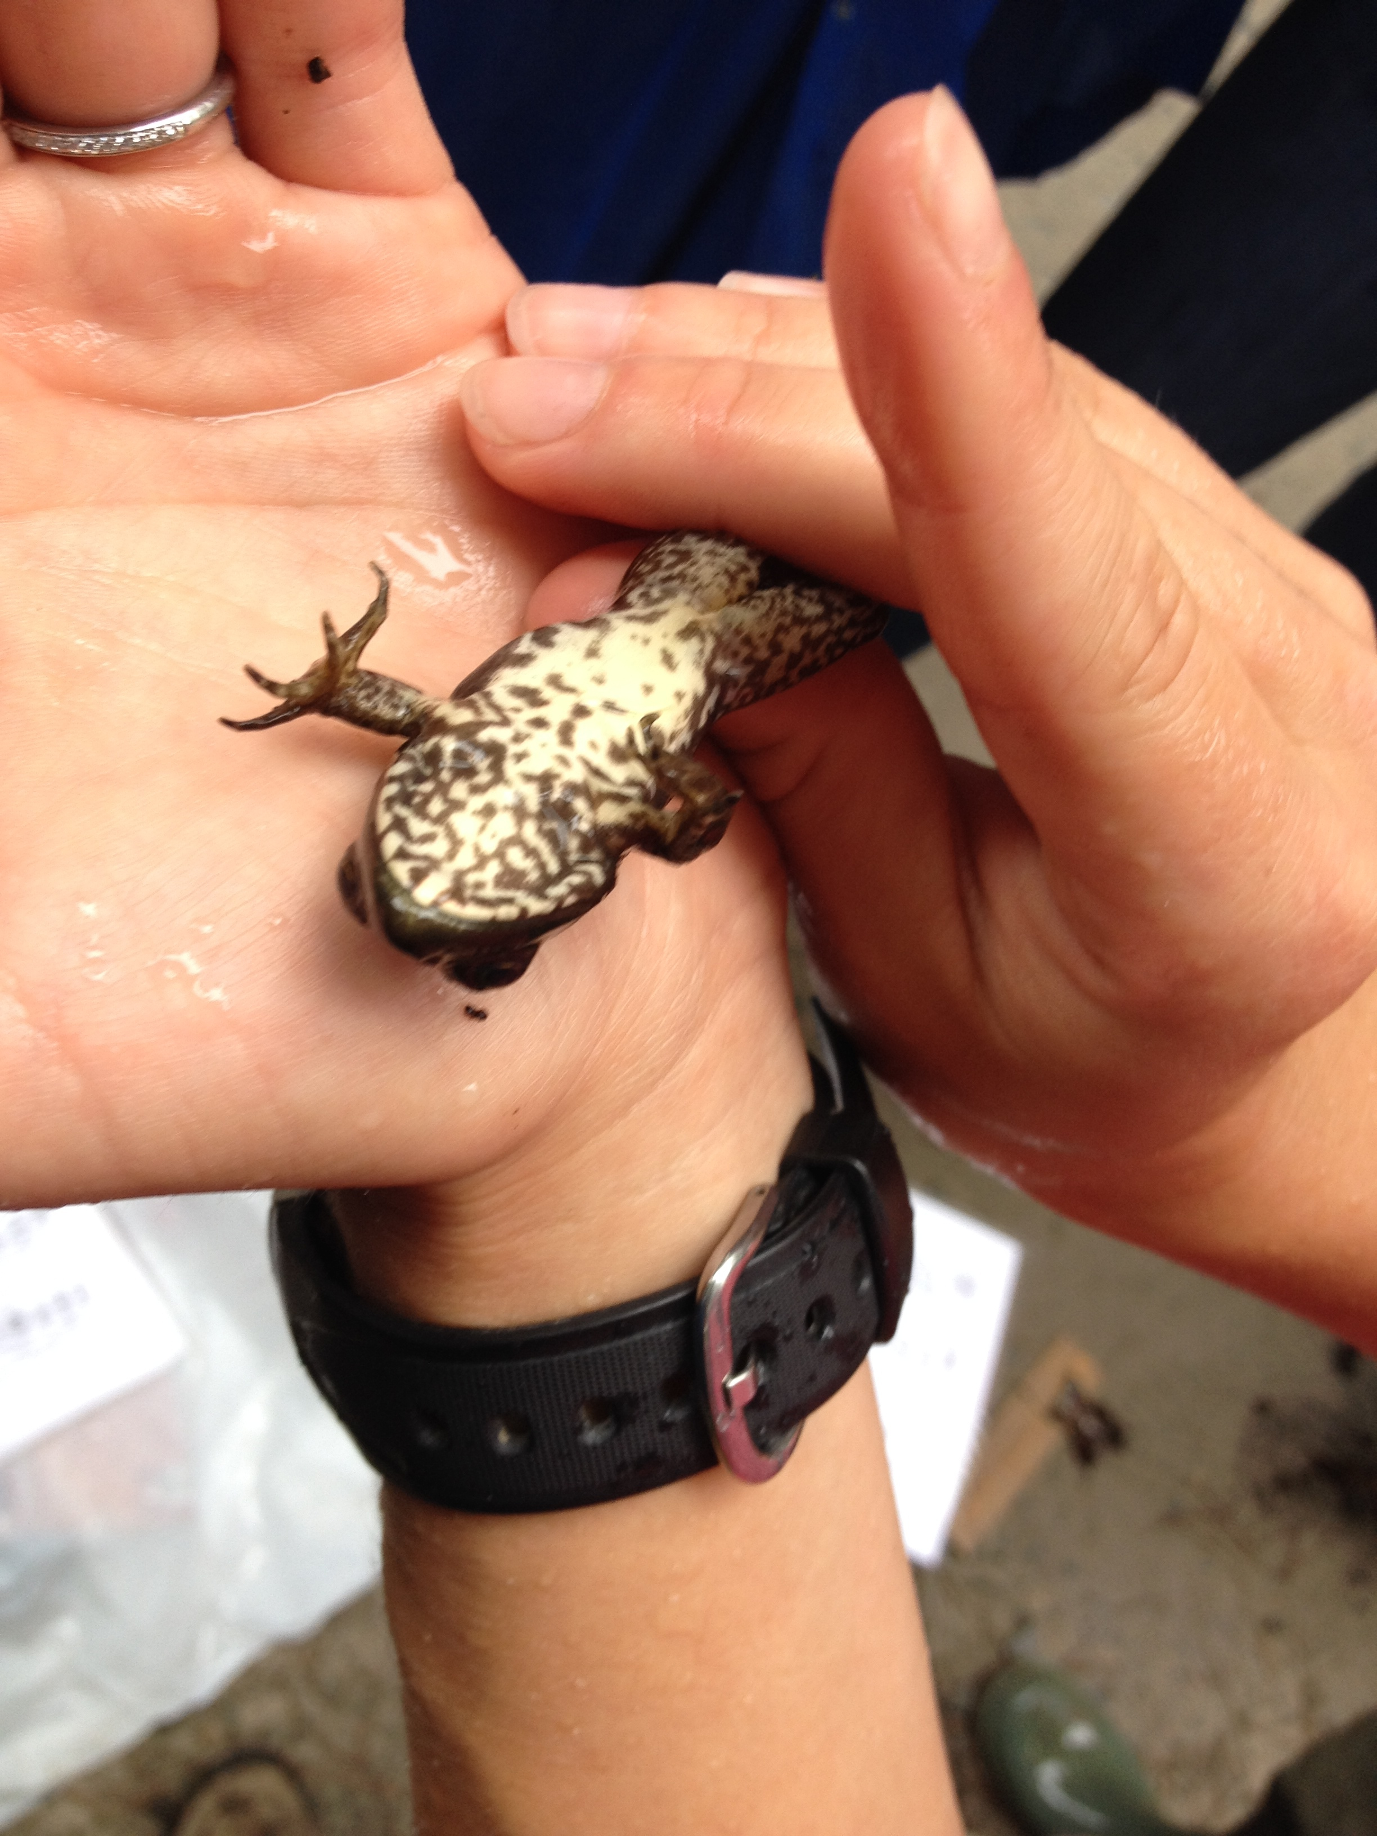
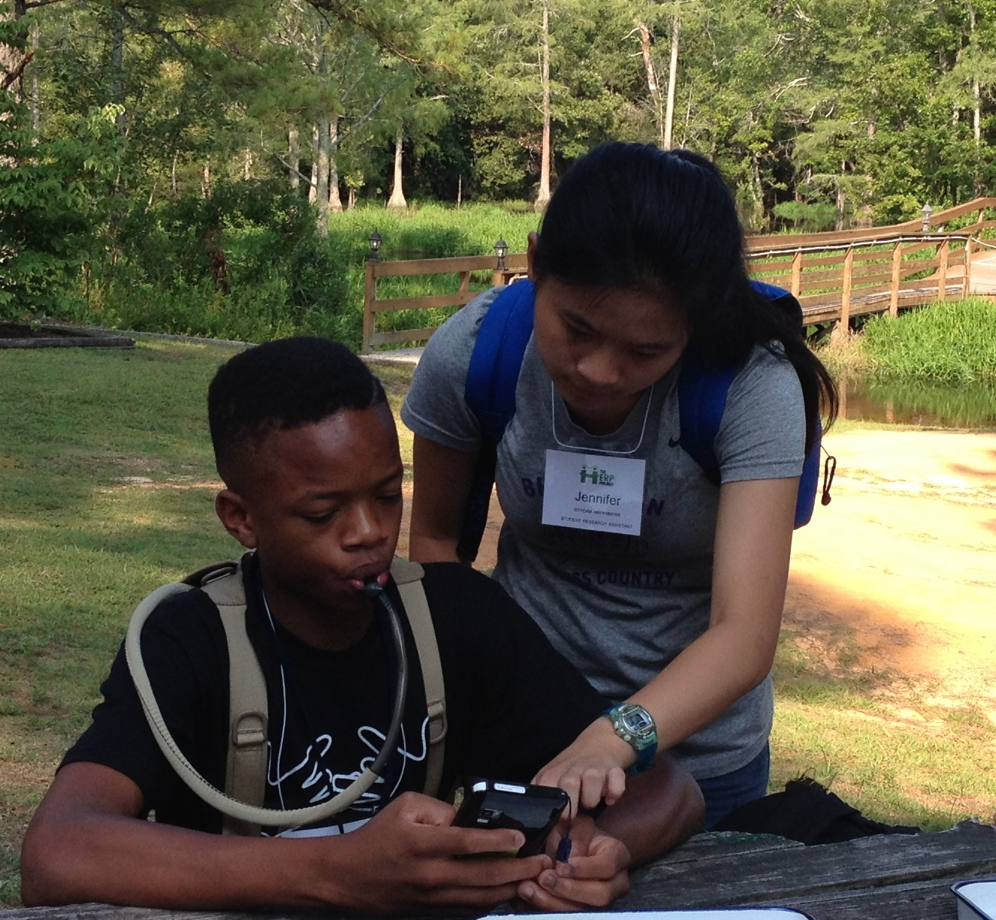
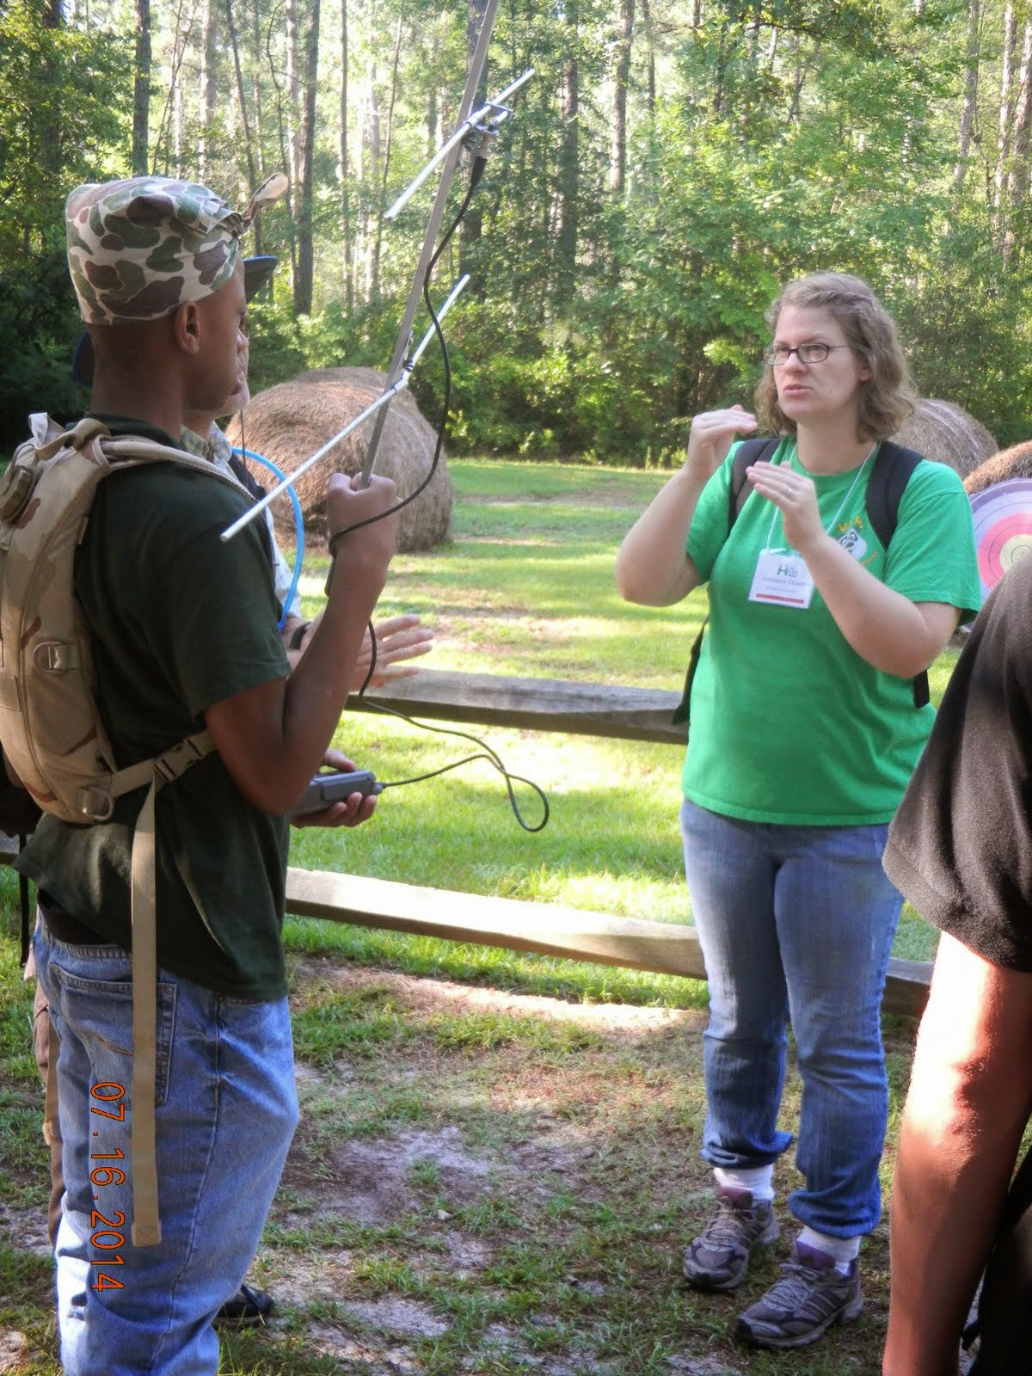
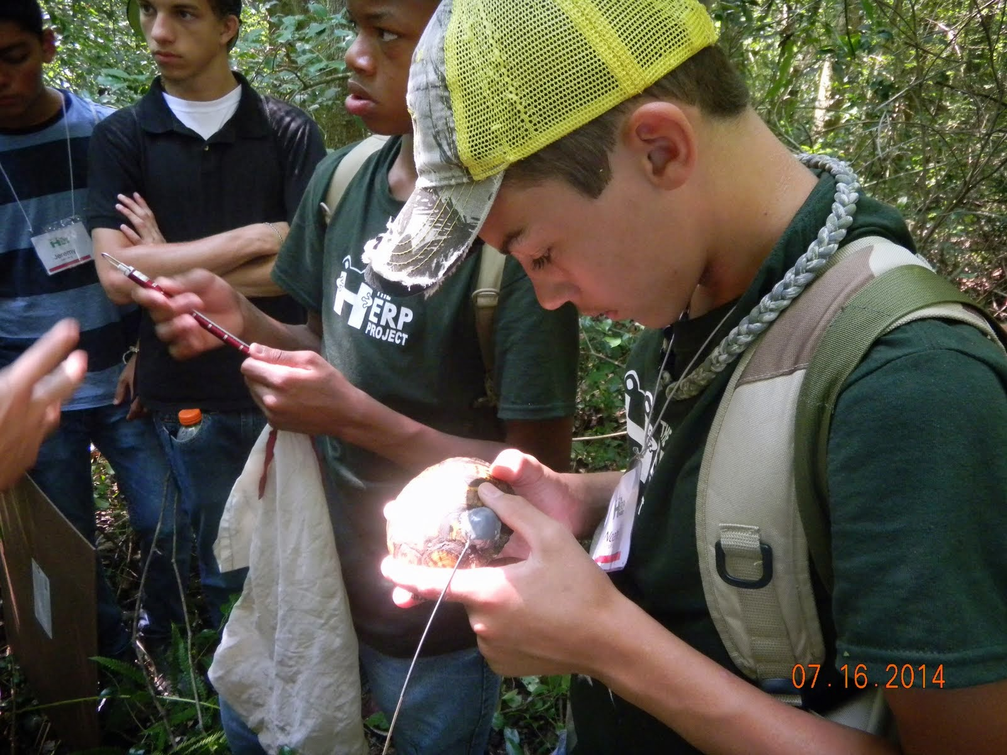
WHO’S INVOLVED?
HERPETOLOGY EDUCATION IN RURAL PLACES & SPACES
AUDIENCES
• University of North Carolina Greensboro
• University of North Carolina Pembroke
• Elon University • Davidson College • NC PARC
• NC State Parks • Nature Centers
Science Educators, Scientists, Historians,
Herpetologists & Computer Scientists
• Public (Community Events - Celebrations, Cyberhub, Apps, Nature Chronicles, Visual Learning Software (VLS))
• High School Students (Residential Herpetological Research Experiences [HRE] & Follow-up Days)
• Teachers & Informal Educators
PROJECT QUESTIONS – EVALUATION RESULTS
Can we ignite a passion for NC’s reptiles & amphibians (r & a)?
• 2014 HRE participants are considering careers in herpetology, biology & environmental sciences. Some have found their passion for learning and even teaching.
• 2014 HRE participants (n=61, 2 groups, posttests, 5.0 scale) rated their interest in science (4.6
and 4.3), understanding of threats that r & a face (4.5 both groups), empathy for animals
(4.5 and 4.4), interest in teaching others about r & a (4.6 and 4.3).
• A majority of 2014 Celebration respondents (n=30, 71%) indicated that they would try to
learn more about or become more involved with r & a.
Can we engage people in conservation & field ecology experiences?
• Respondents (n=36, 80%) indicated that they would change their behaviors in ways that
would support r & a and/or their habitats because of attending the 2014 Celebration.
• 2014 HRE participants rated ability to use scientific tools (4.5 and 4.2).
Can we help people develop a sense of place & a connection to the local environment?
• 2014 HRE participants rated connection to nature (4.4 and 4.5).
• “I liked the aquatic turtles and the snakes the best because I love aquatic turtles to begin with,
and it gave me an opportunity to learn more. But the HRE really changed my feelings about
snakes; now I love snakes.” [participant exit interview, 2014]
Can we promote the public’s participation in scientific research?
• Participants in The HERP Project are enrolling in and entering data on r & a as citizen scientists in
The Carolina Herp Atlas (www.carolinaherpatlas.org).
• State Parks and Nature Centers are collecting and entering data on box turtles throughout NC.
CHALLENGES
• Not enough time! • Meeting needs of special needs students & their parents
• Sustaining the project! • Evolution of website, Cyberhub
• Development of data collection apps & VLS
This project is supported by the National Science Foundation, Grant No. DRL-1114558.

